Slide 1
RNA-seq analysis workshop
Presented by Donovin Coles
27 November 2024

Slide 2
Layout of workshop
Introduction to RNA-seq analysis
Mapping of RNA-seq data (CLC Genomics Workbench)
Differential expression analysis
Down-stream exploration of data (Venn, heatmaps, functional annotation, PLS-DA etc)
Hands on tutorial

Slide 3
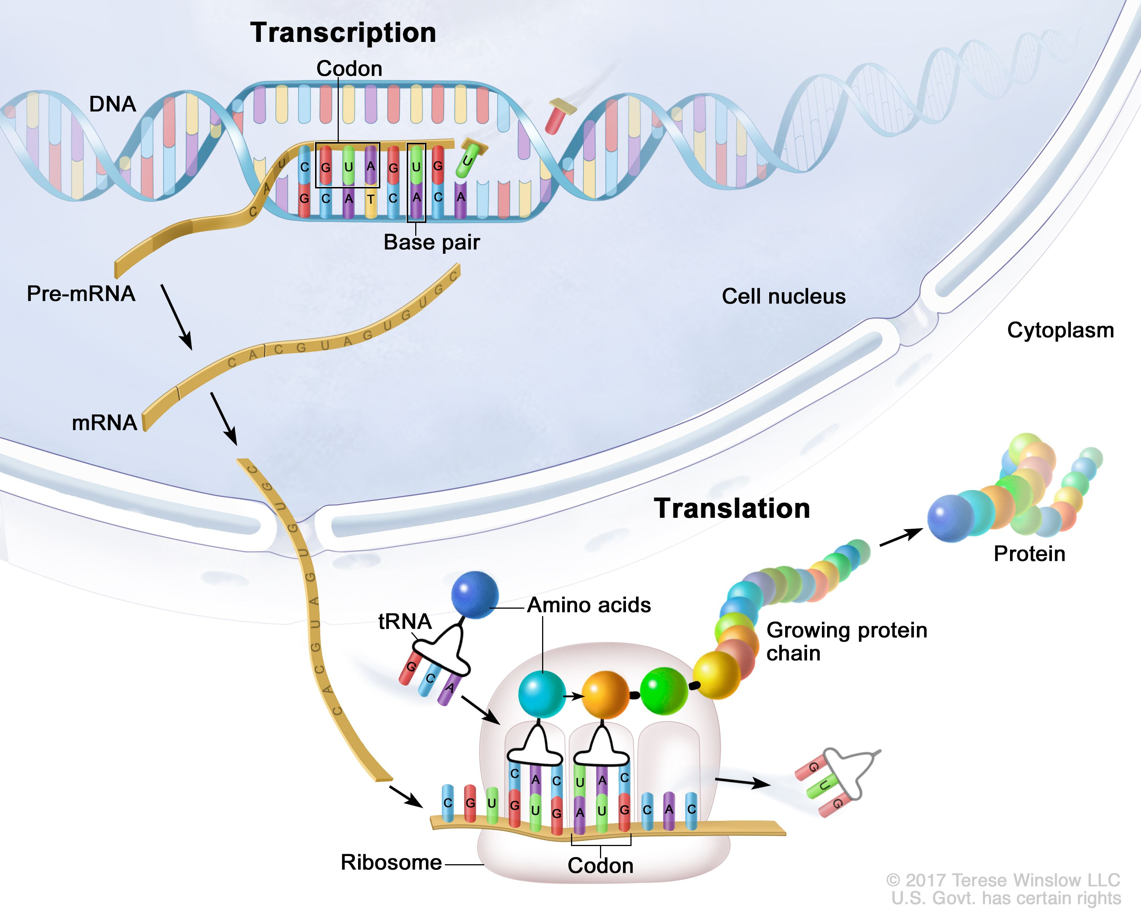
1. Introduction – RNA-seq analysis
A technique that measures the transcription of each gene in a biological sample - Transcriptome
By comparing treatment and control samples we can determine which genes are turned on and which genes are turned off – Infer function

Slide 4
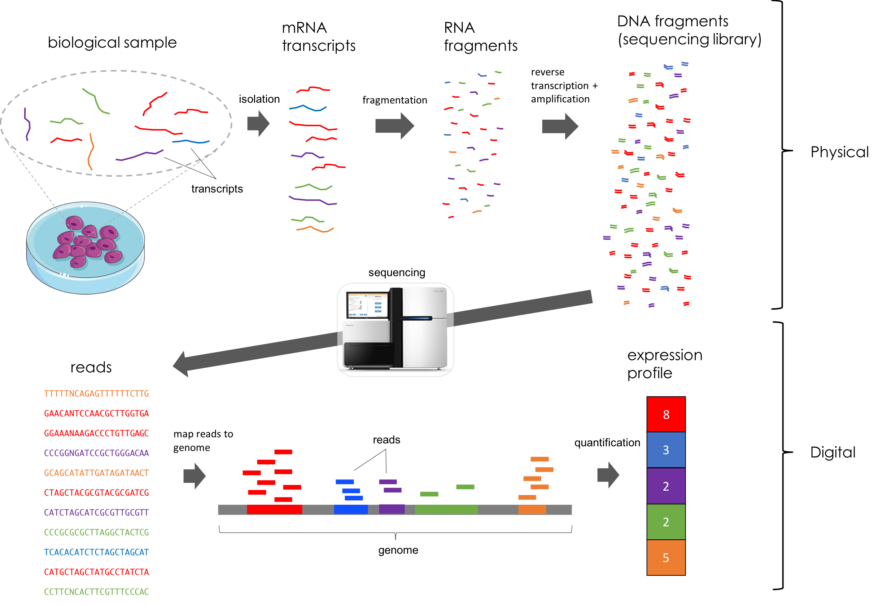
Steps in RNA-seq analysis
4.
3.
1.
2.
5.
6.
https://mbernste.github.io/posts/rna_seq_basics/

Slide 5
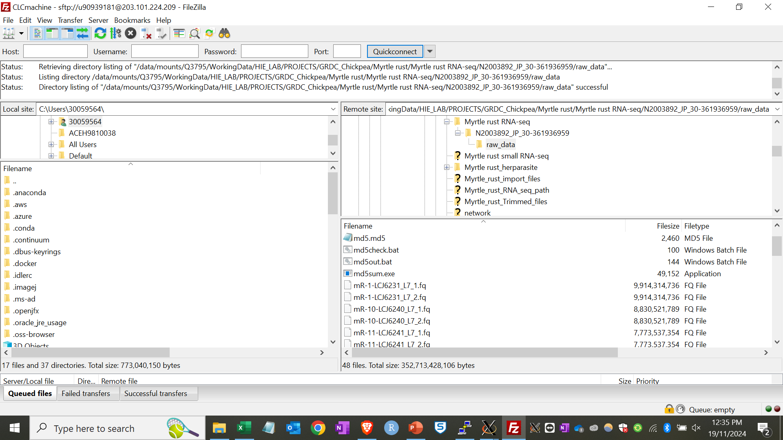
Uploading RNA-seq files to w0565 machine

Slide 6



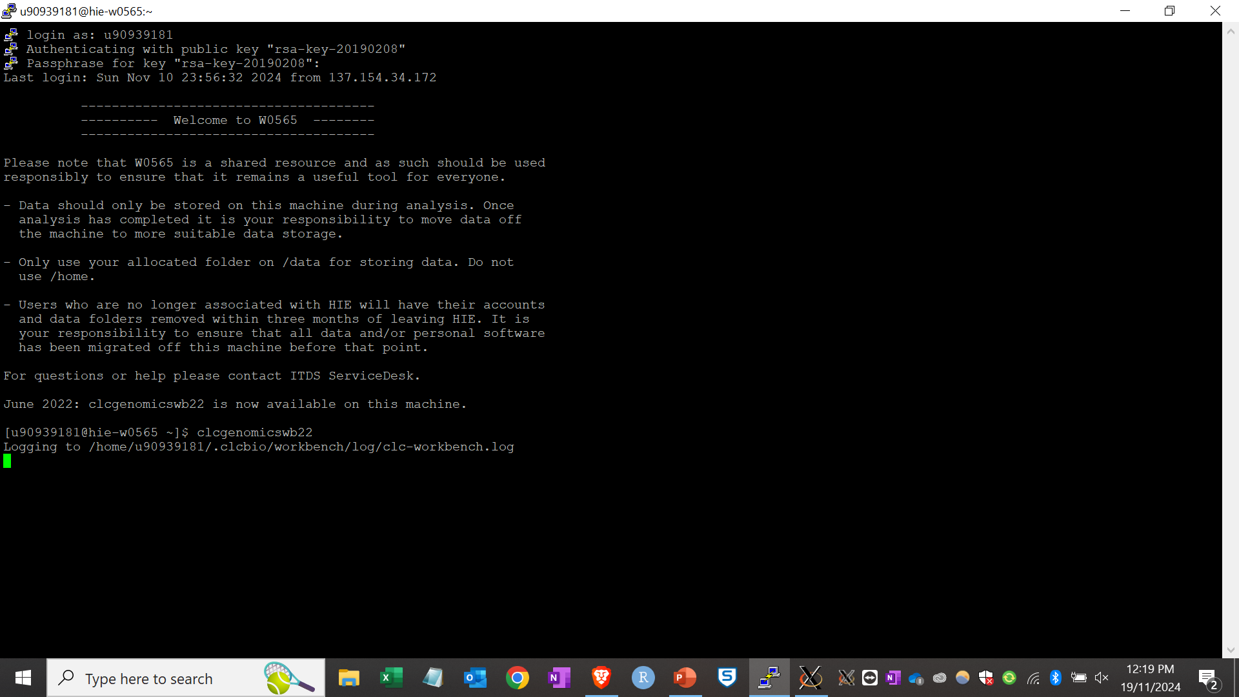
2. Mapping reads to genome
Log onto the w0565 machine with staff ID (909…. number) and password
Open clcgenomicswb22

Slide 7
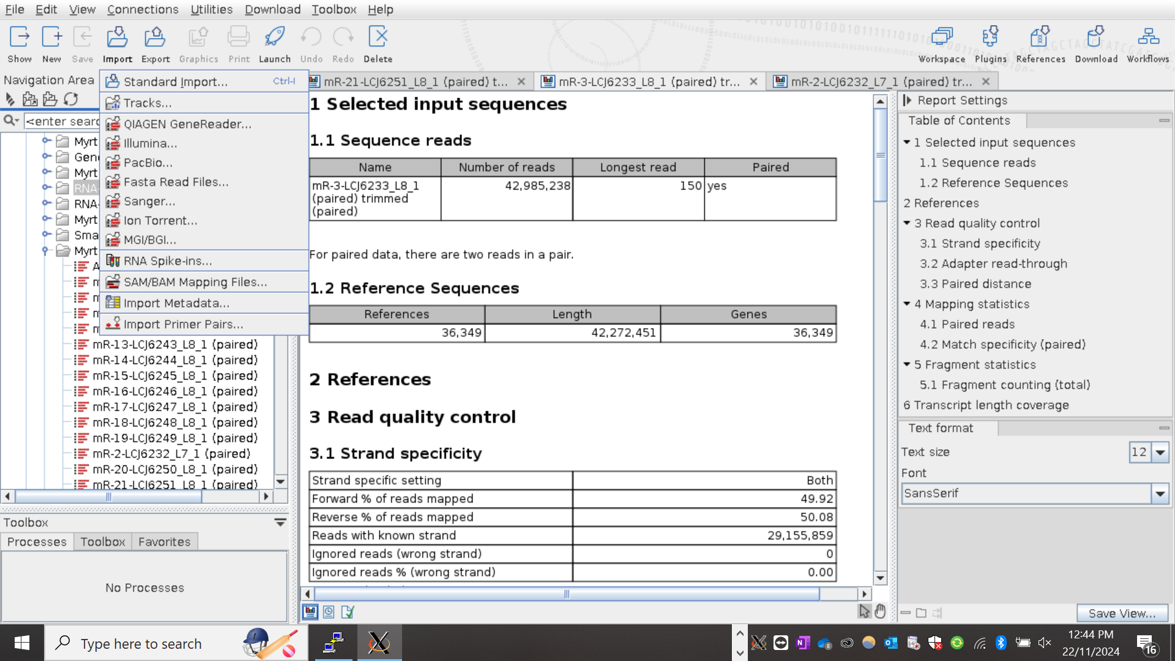
Importing a genome

Slide 8
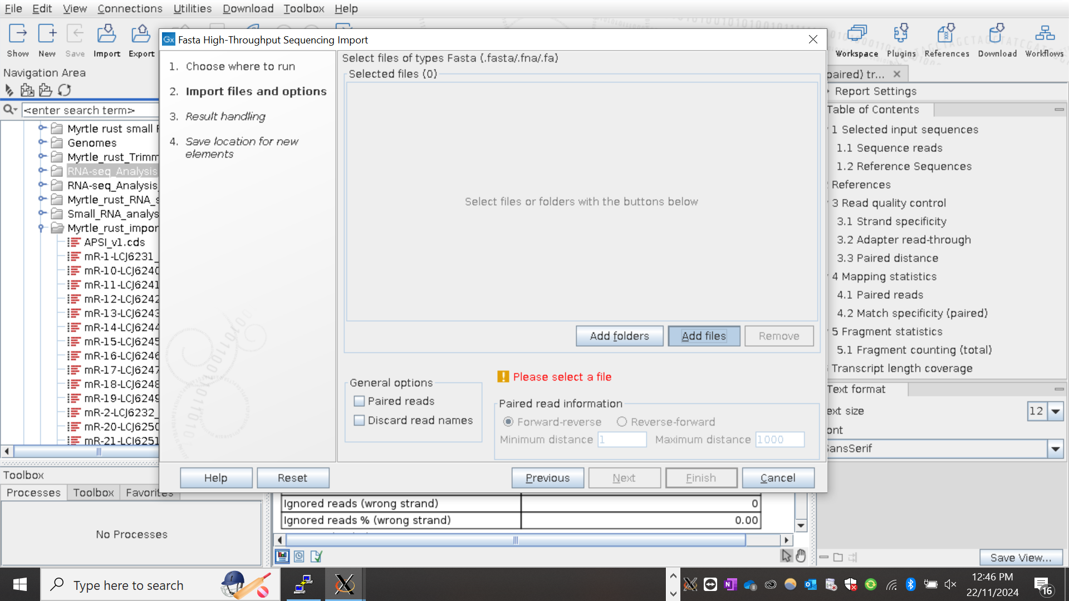
Importing a genome

Slide 9
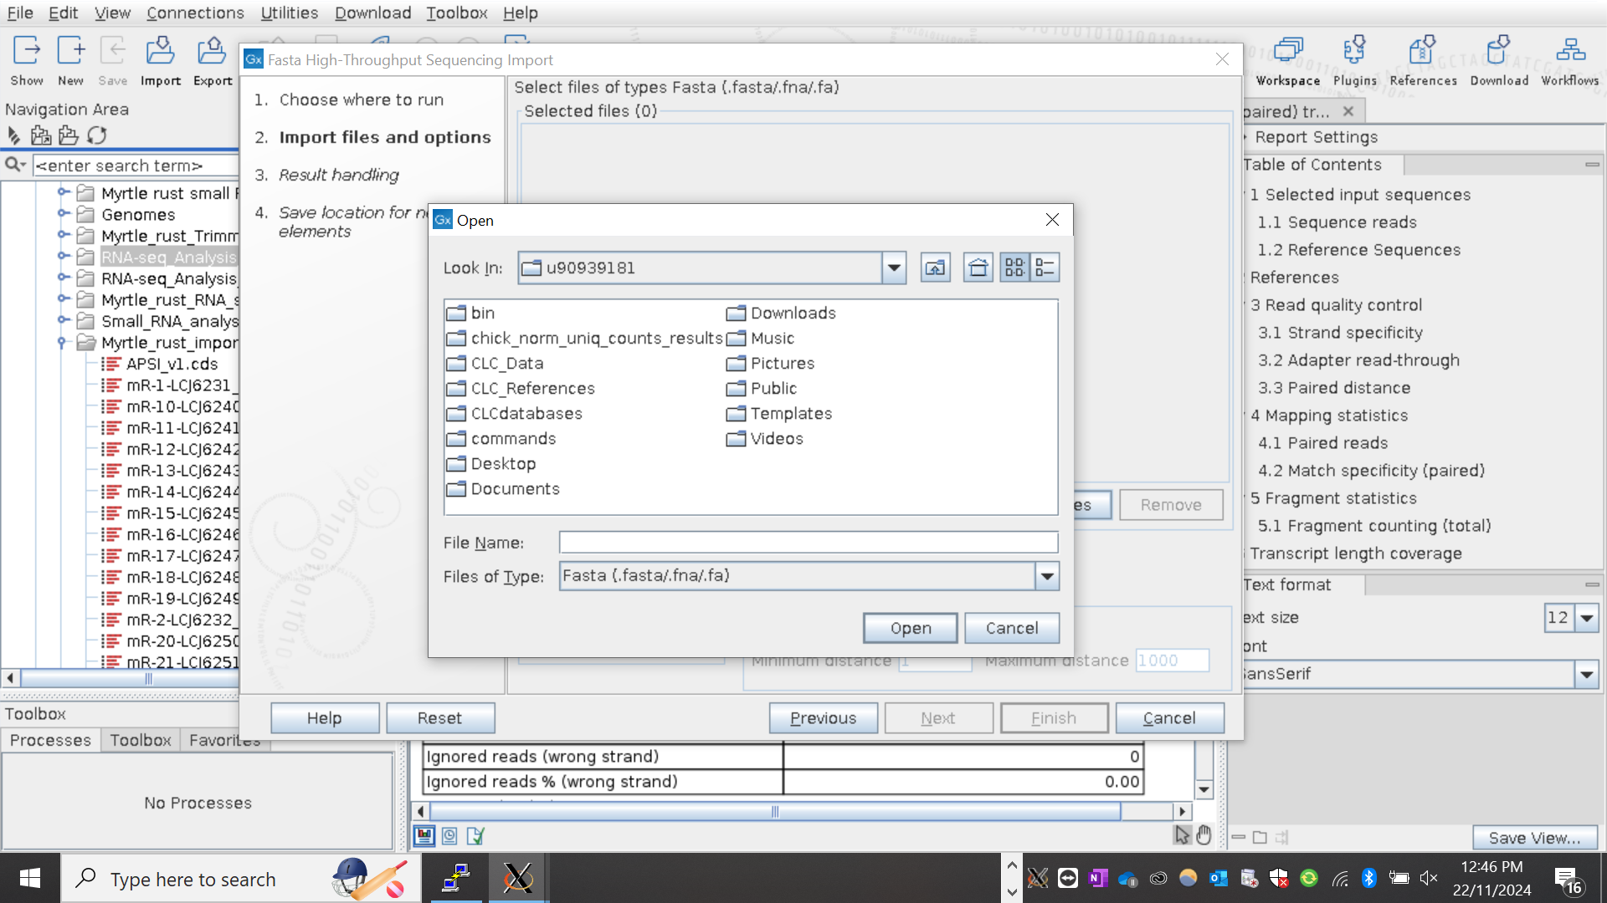
Importing a genome

Slide 10
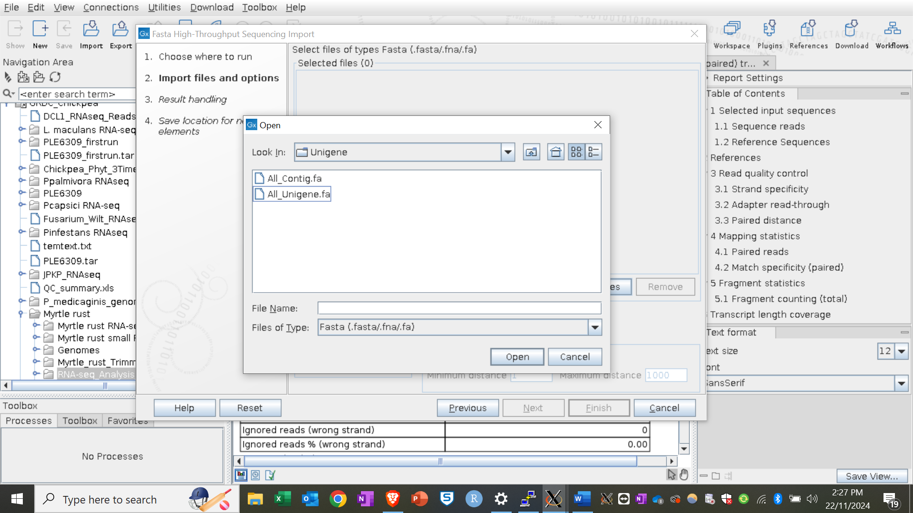
Importing a genome

Slide 11
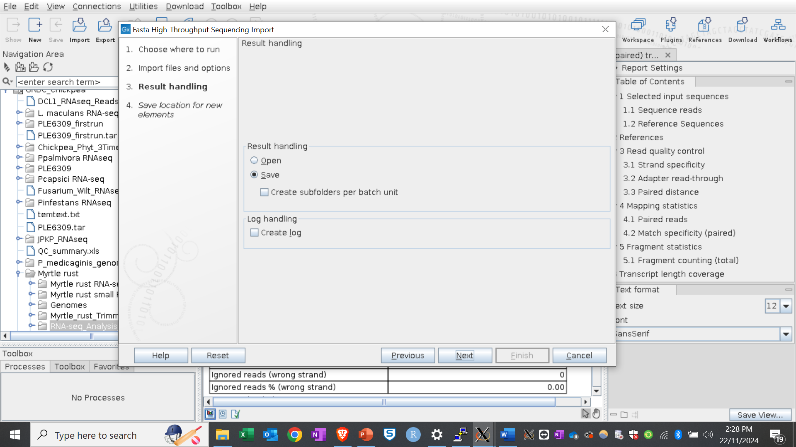
Importing a genome

Slide 12
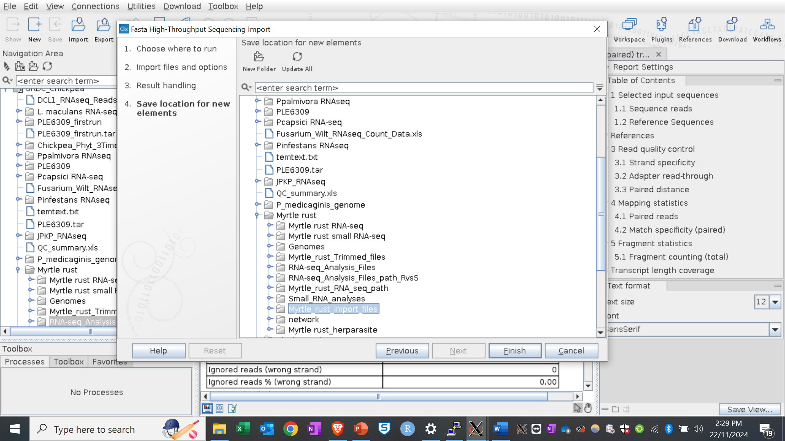
Importing a genome

Slide 13
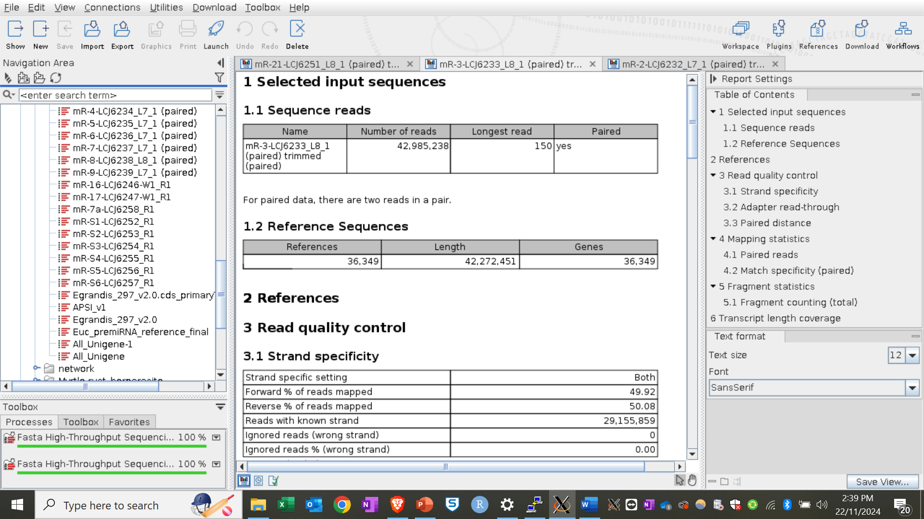
Importing a genome

Slide 14
Importing RNA-seq fasta files

Slide 15
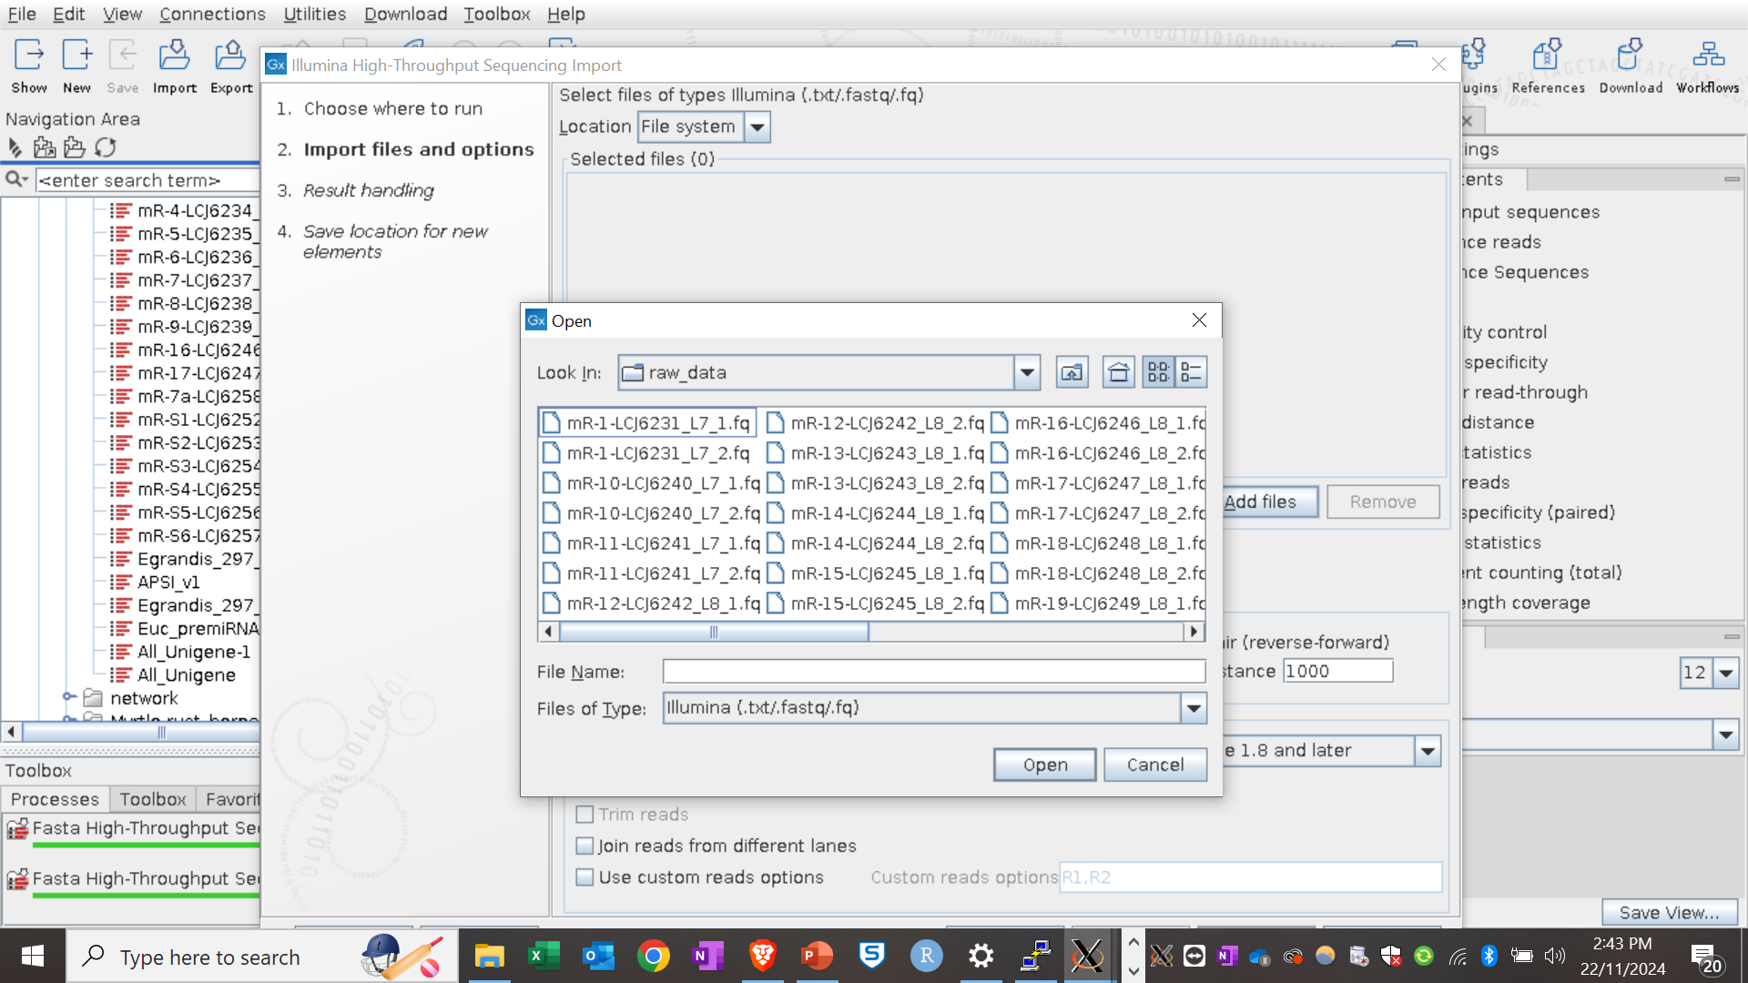
Importing RNA-seq fasta files

Slide 16
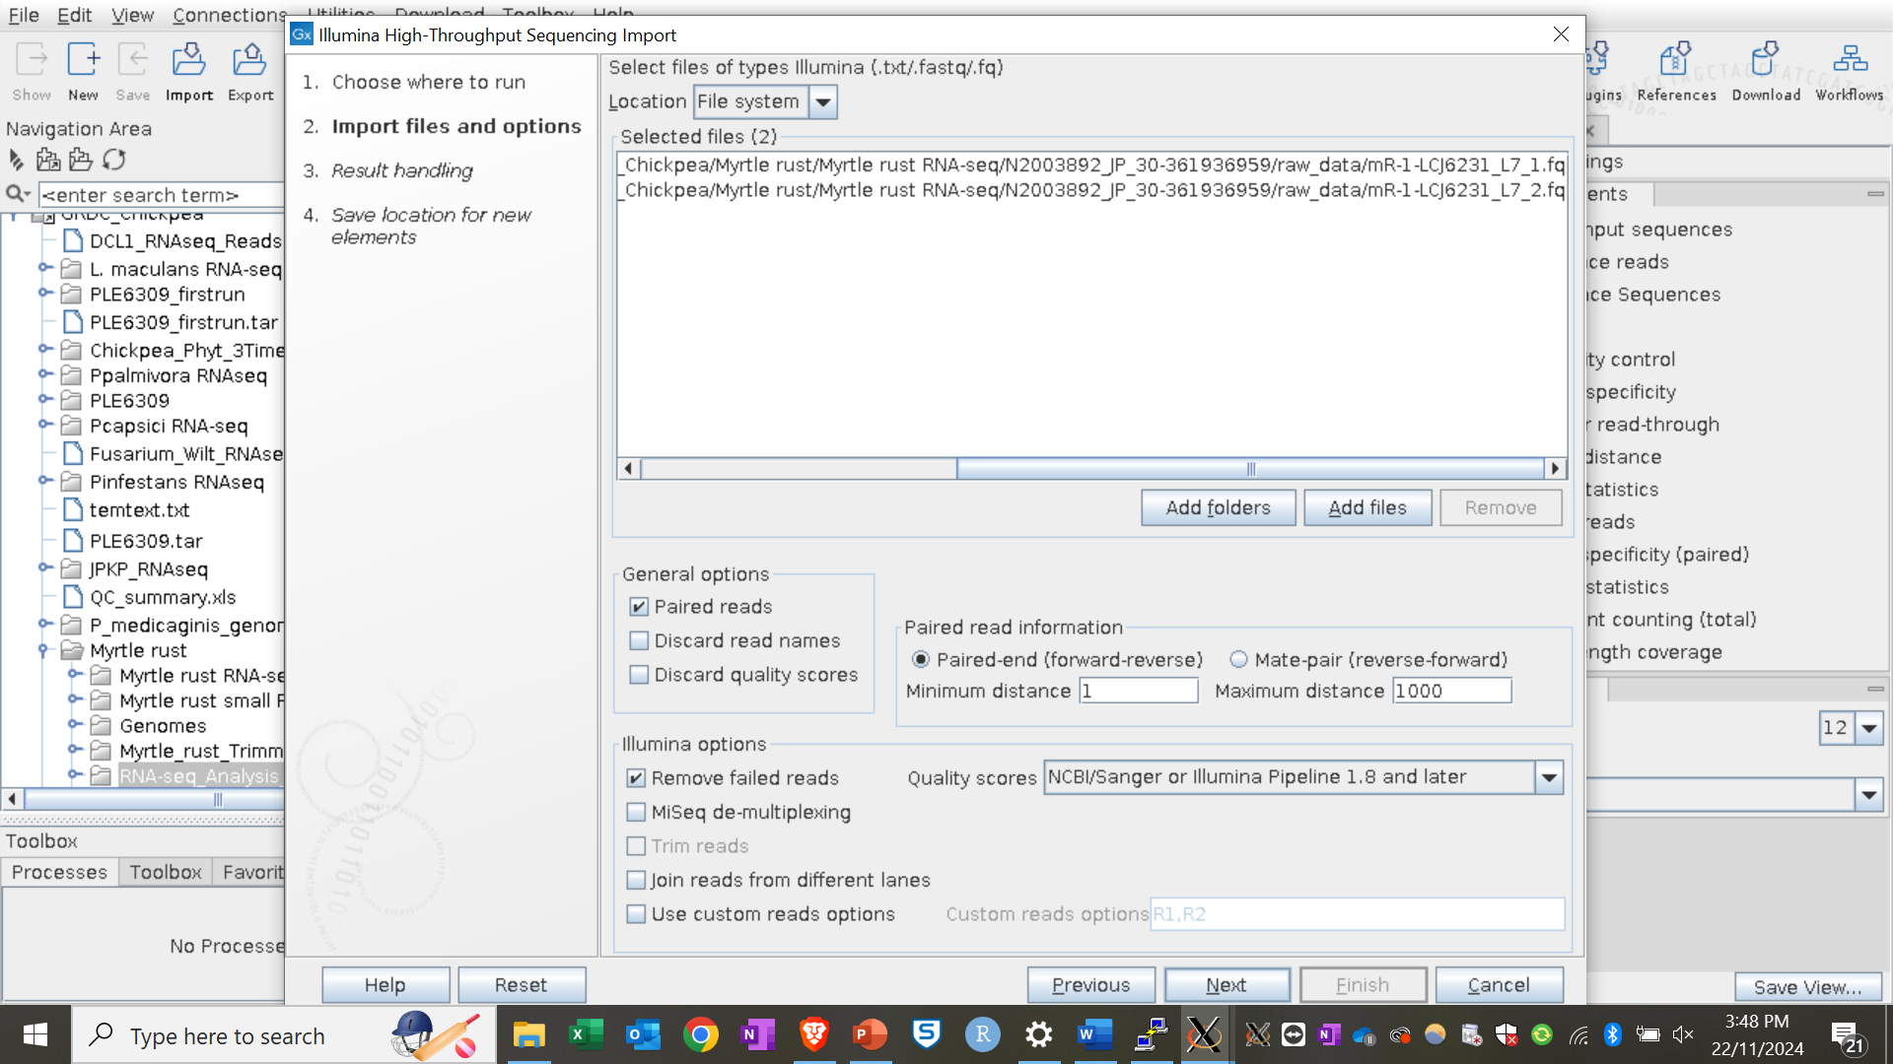
Importing RNA-seq fasta files

Slide 17
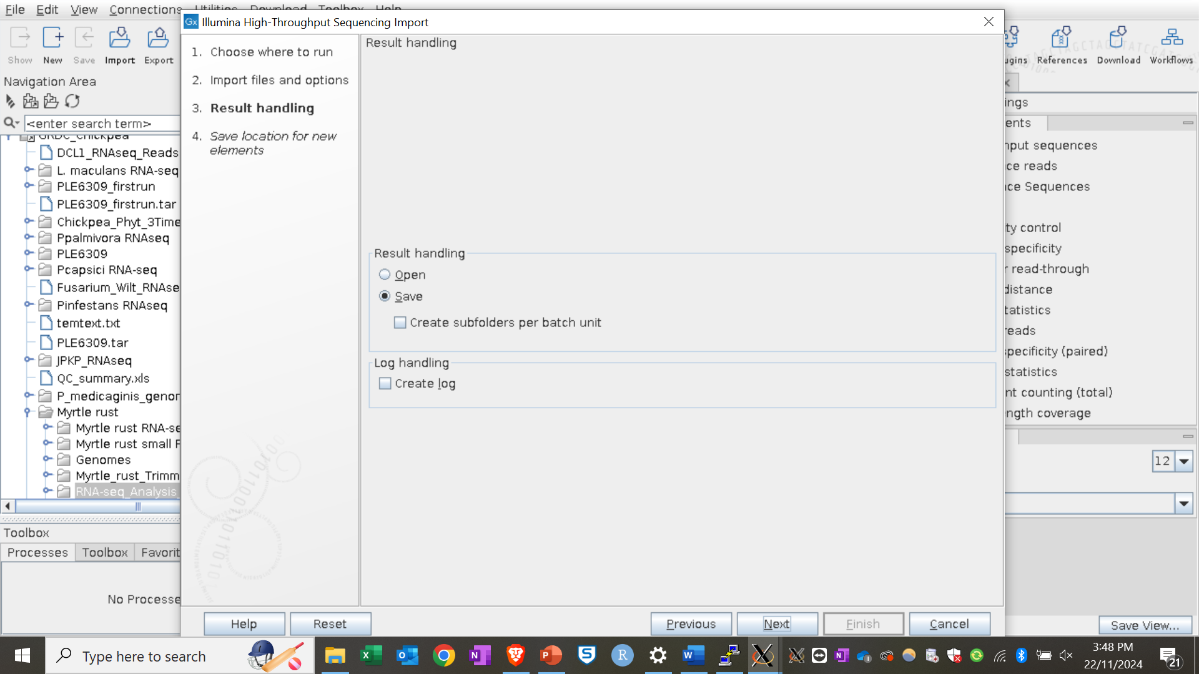
Importing RNA-seq fasta files

Slide 18
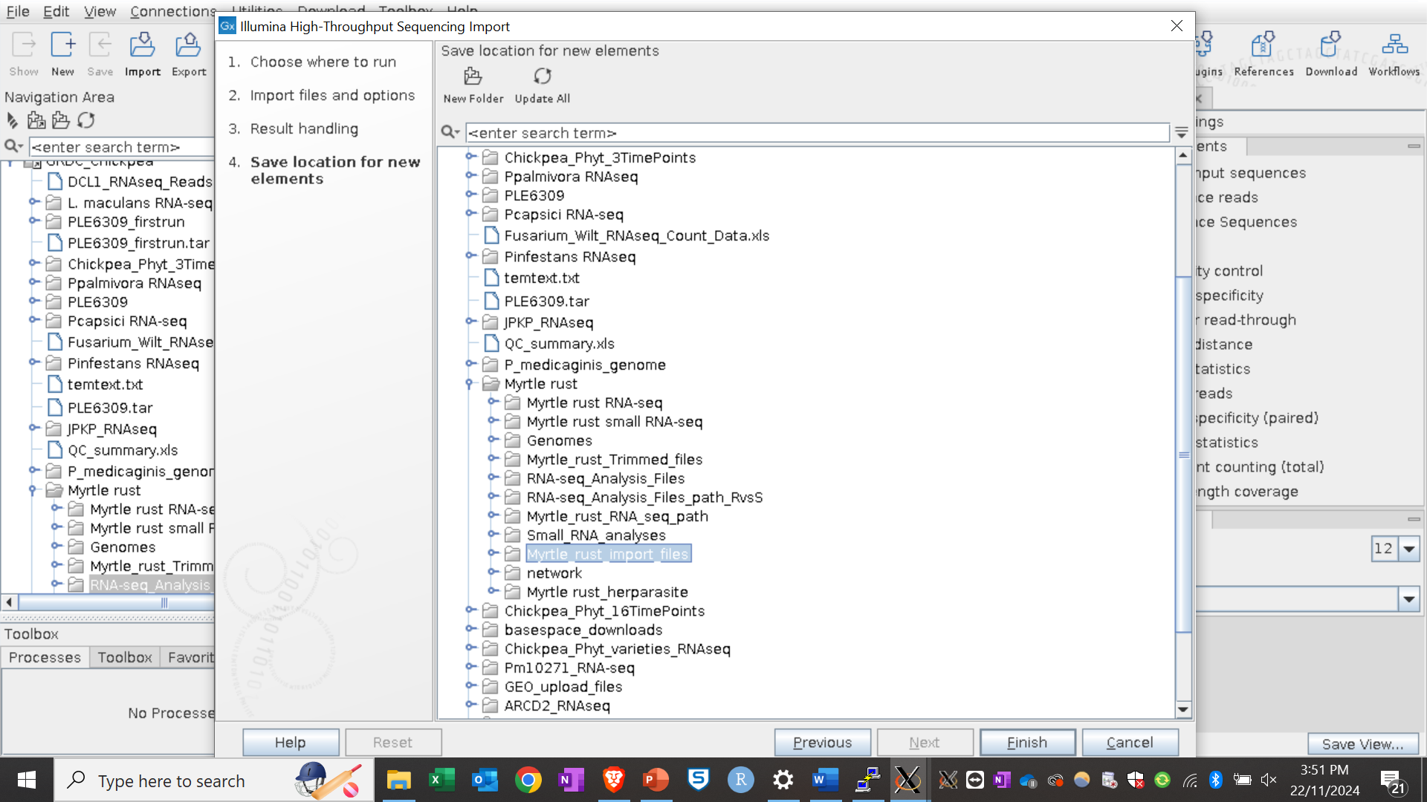
Importing RNA-seq fasta files

Slide 19
Imported RNA-seq fasta files

Slide 20
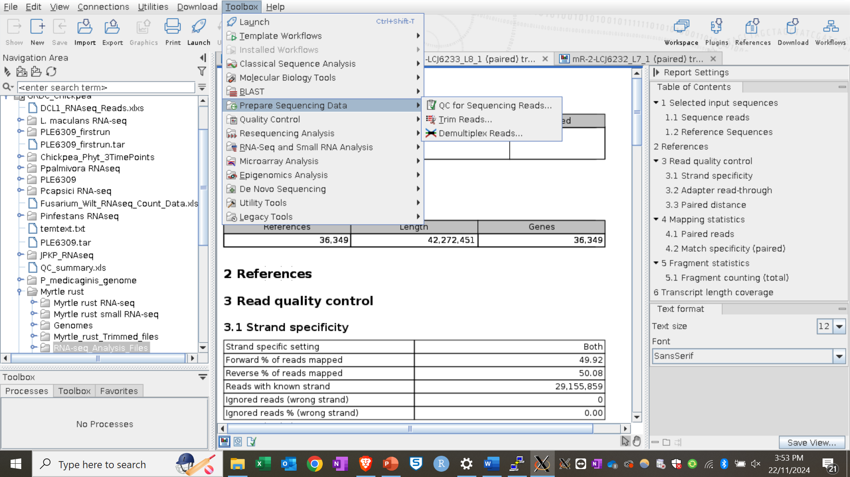
Trimming RNA-seq reads

Slide 21
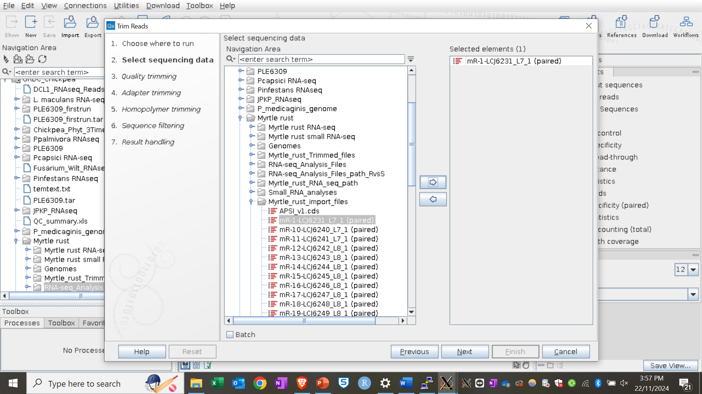
Trimming RNA-seq reads

Slide 22
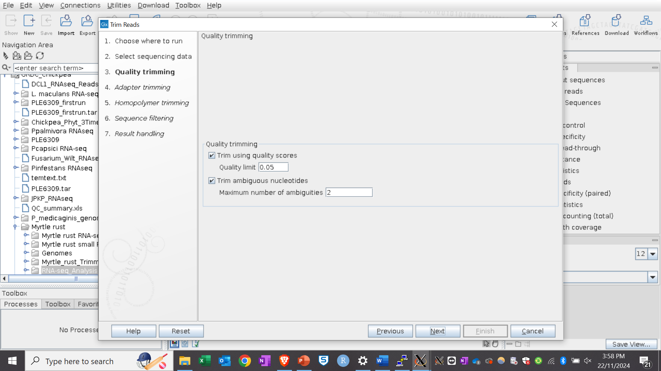
Trimming RNA-seq reads

Slide 23
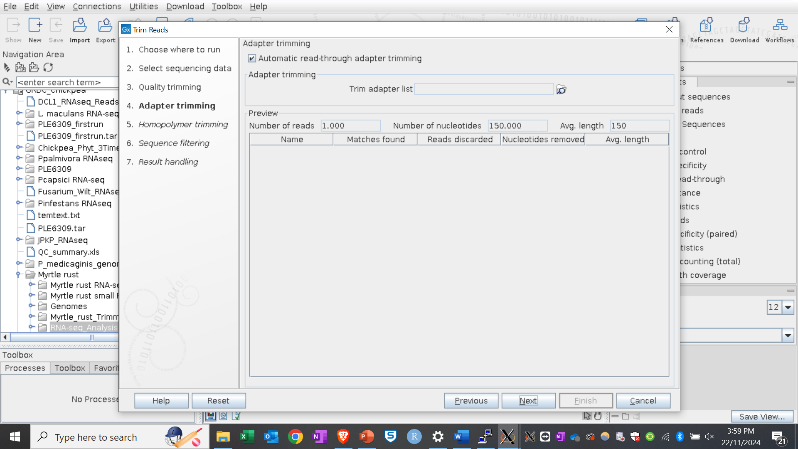
Trimming RNA-seq reads

Slide 24
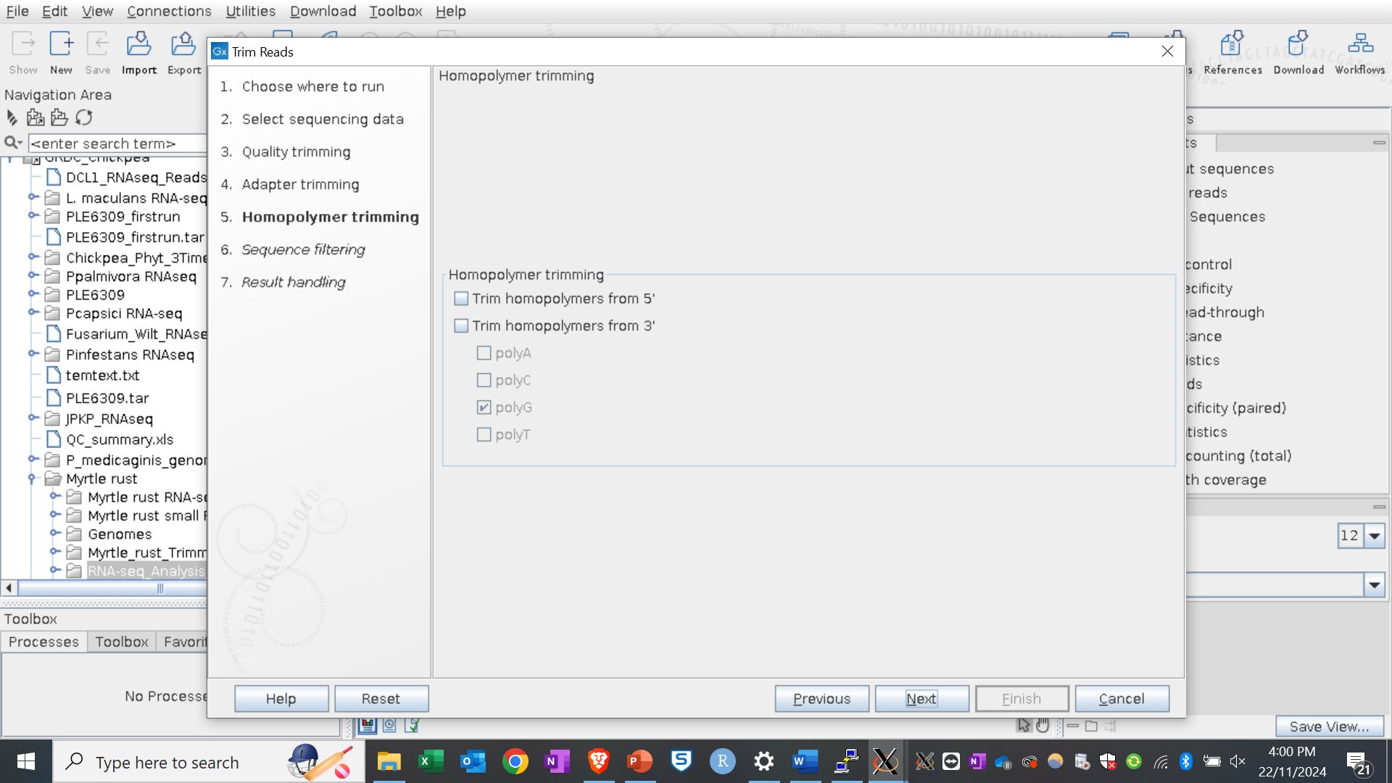
Trimming RNA-seq reads

Slide 25
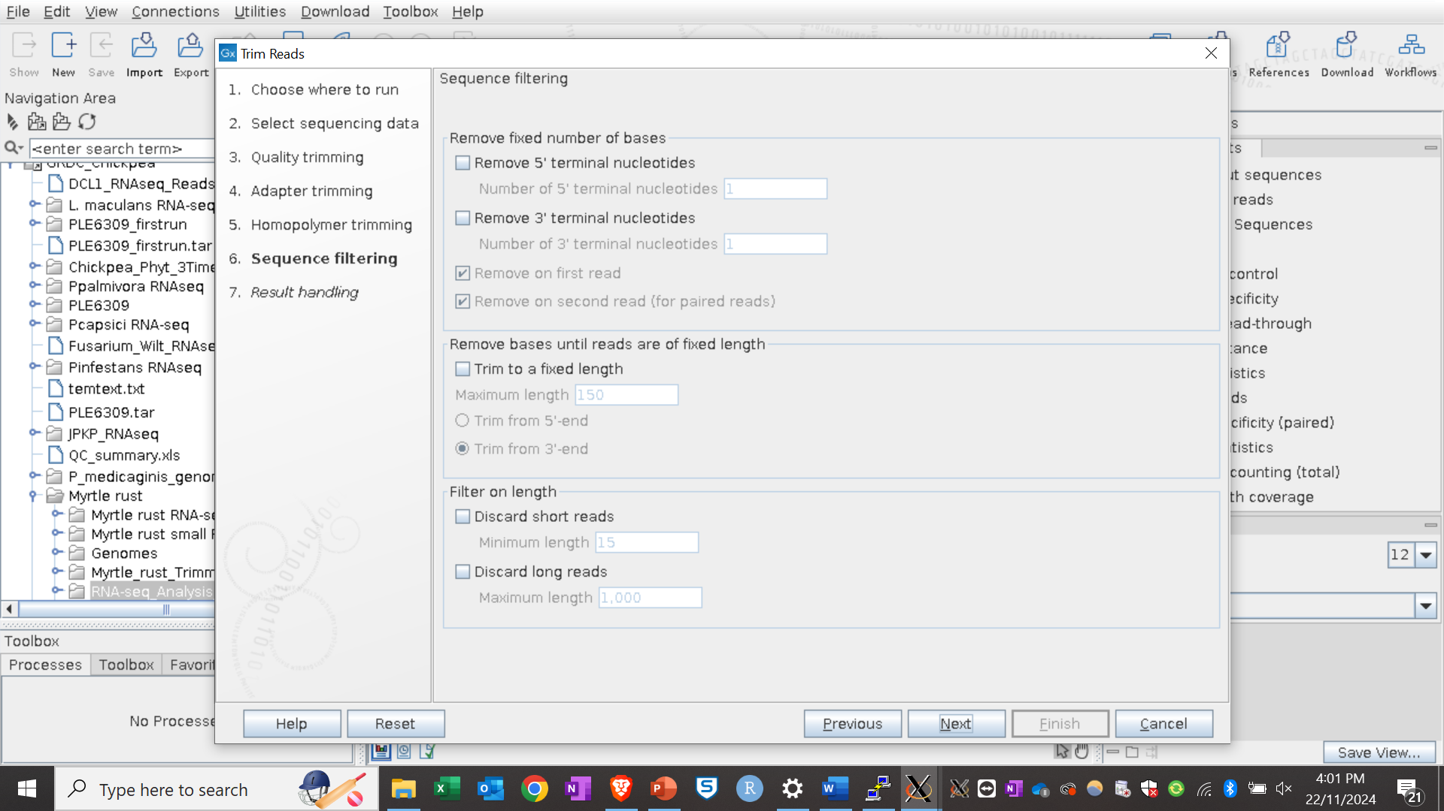
Trimming RNA-seq reads

Slide 26
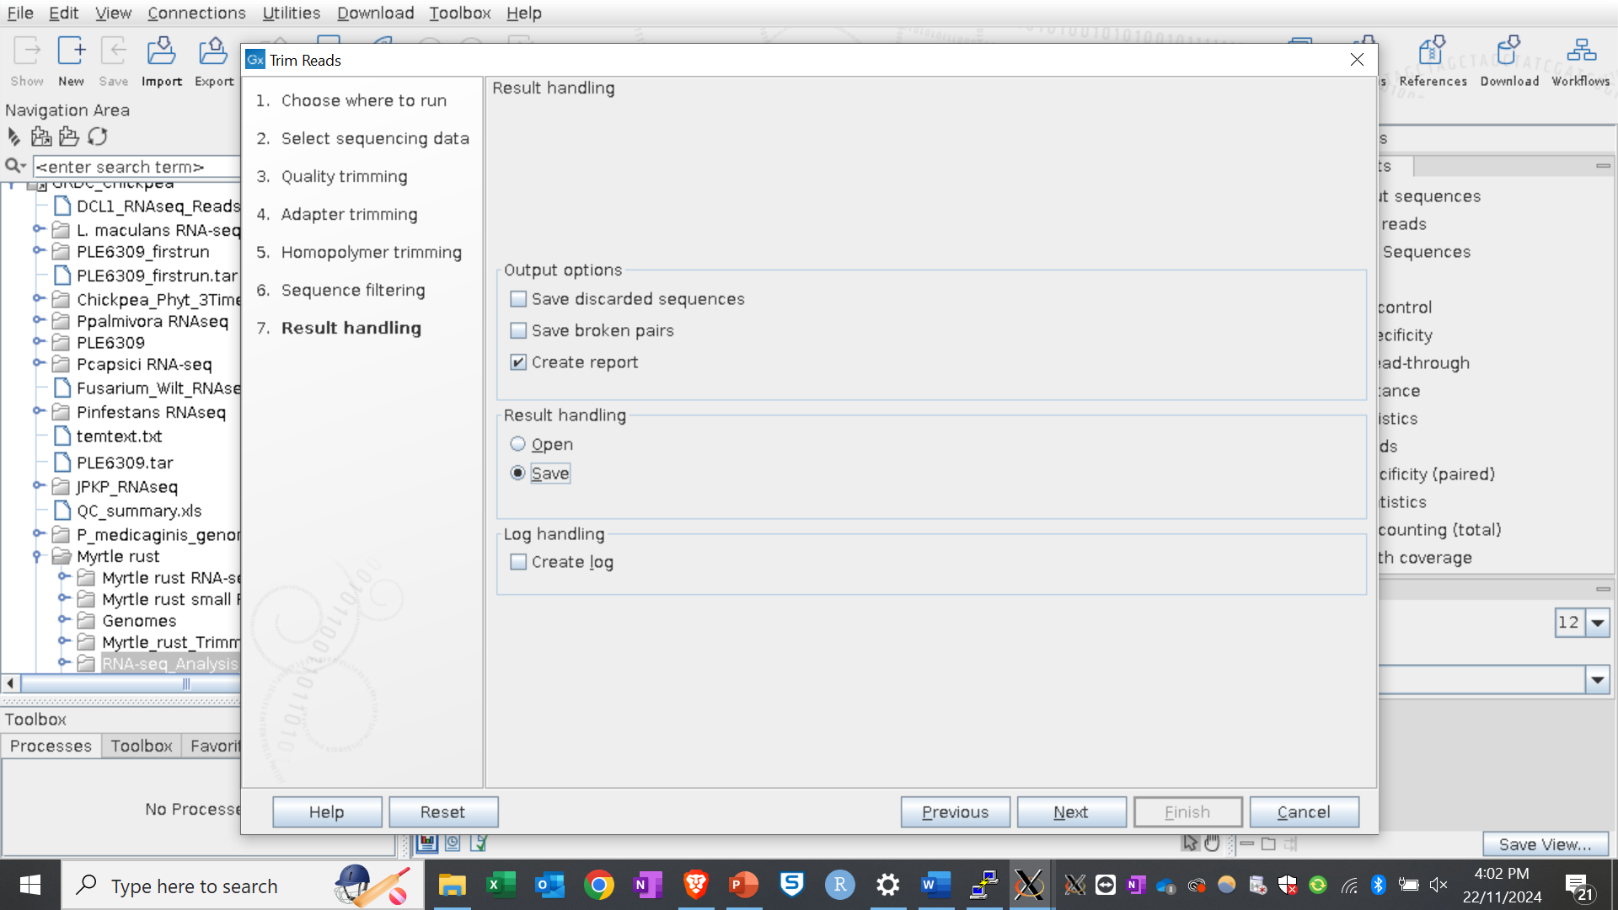
Trimming RNA-seq reads

Slide 27
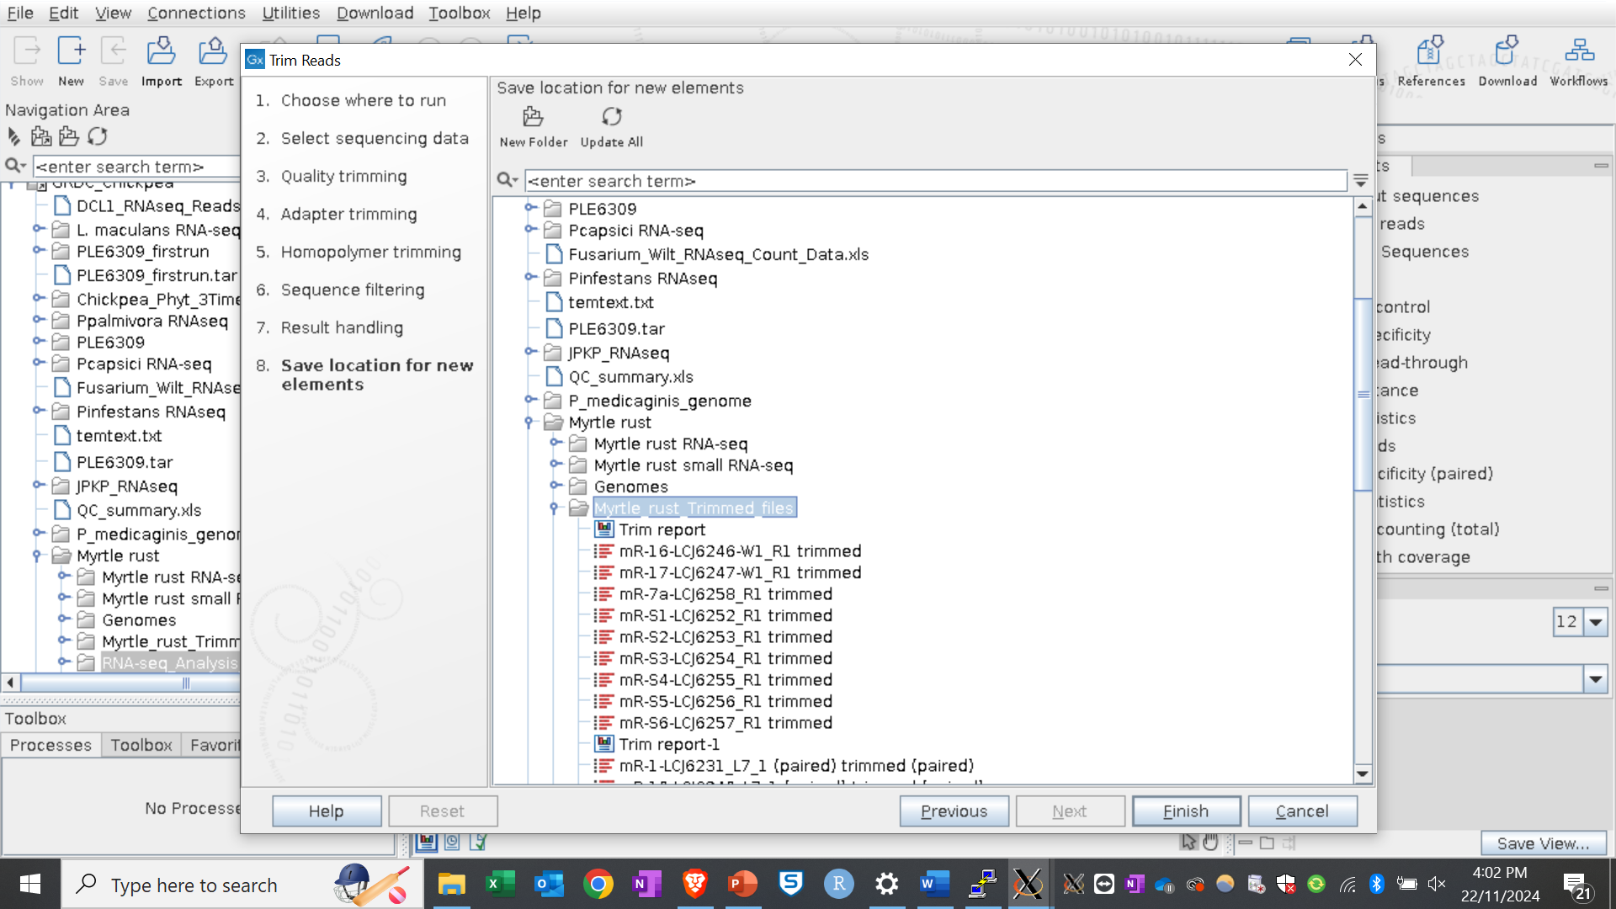
Trimming RNA-seq reads

Slide 28
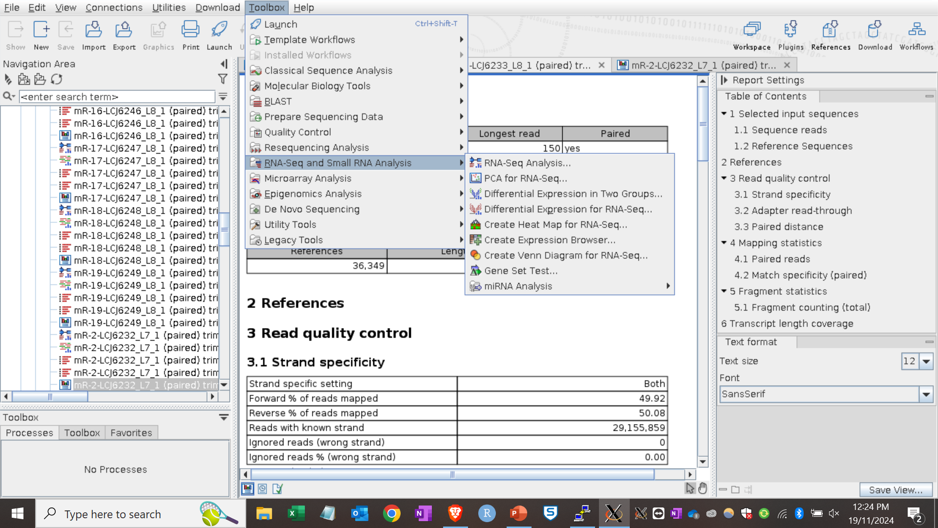
Performing mapping

Slide 29
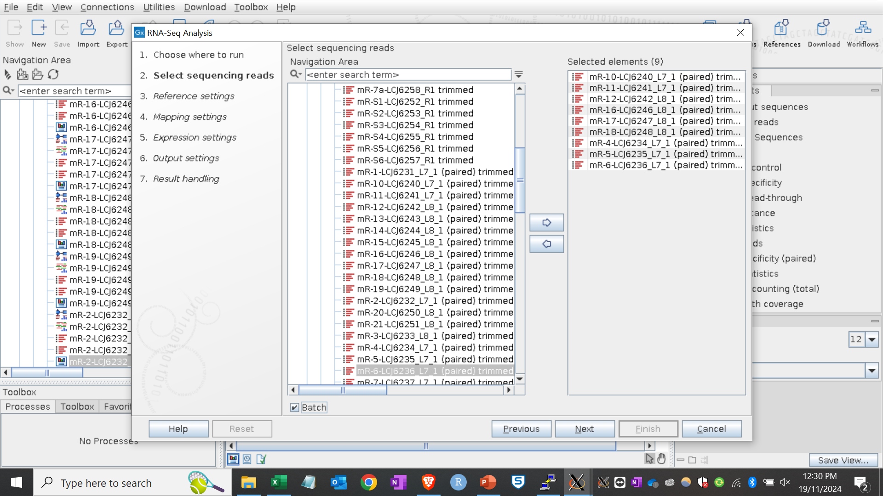
Selecting RNA-seq samples

Slide 30
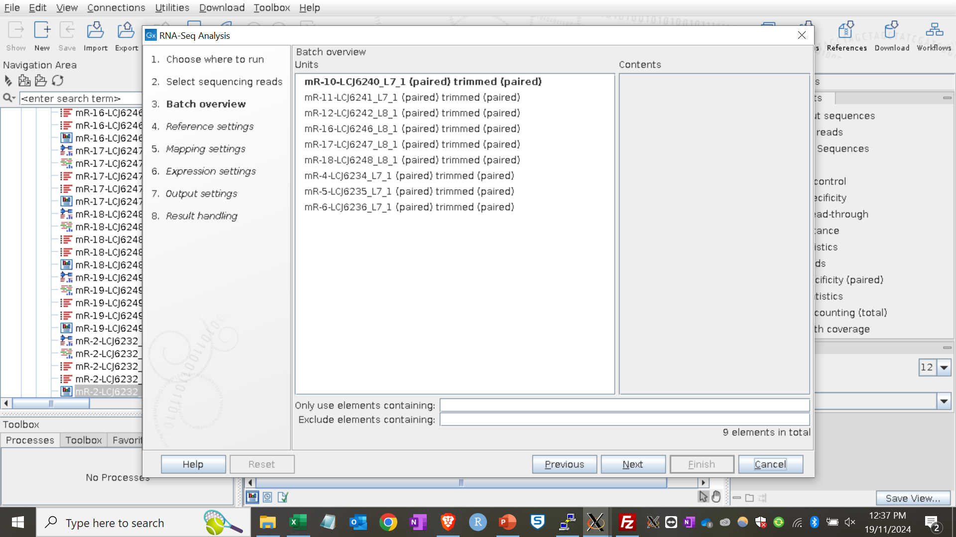
Overview of selected files

Slide 31
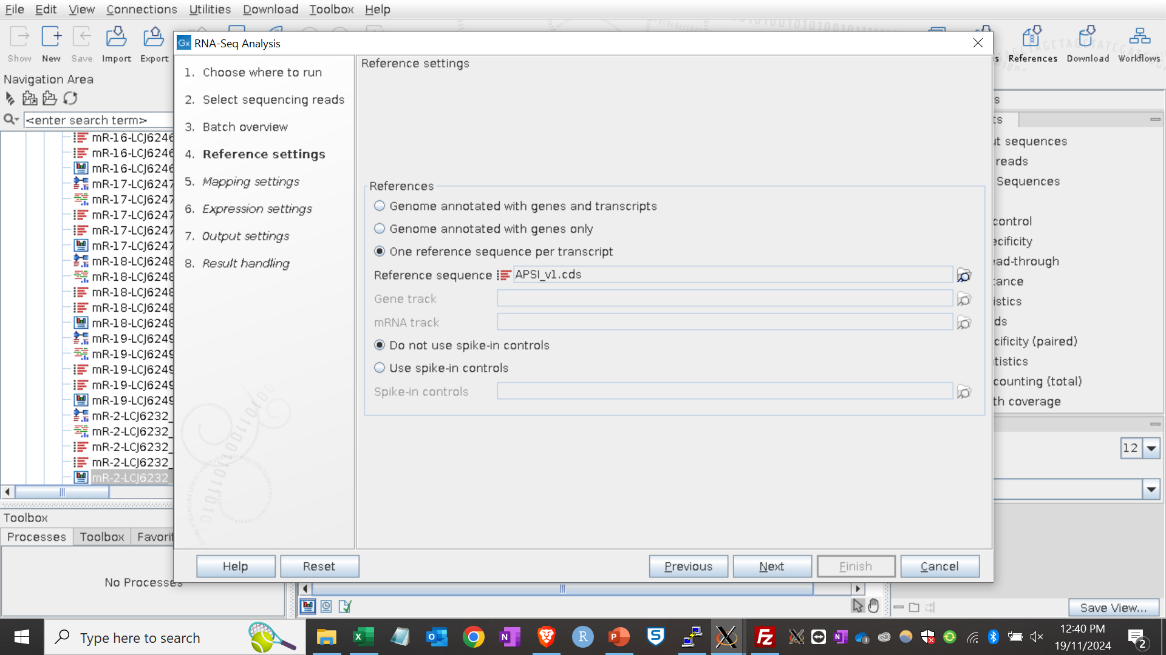
Select reference genome to map to

Slide 32
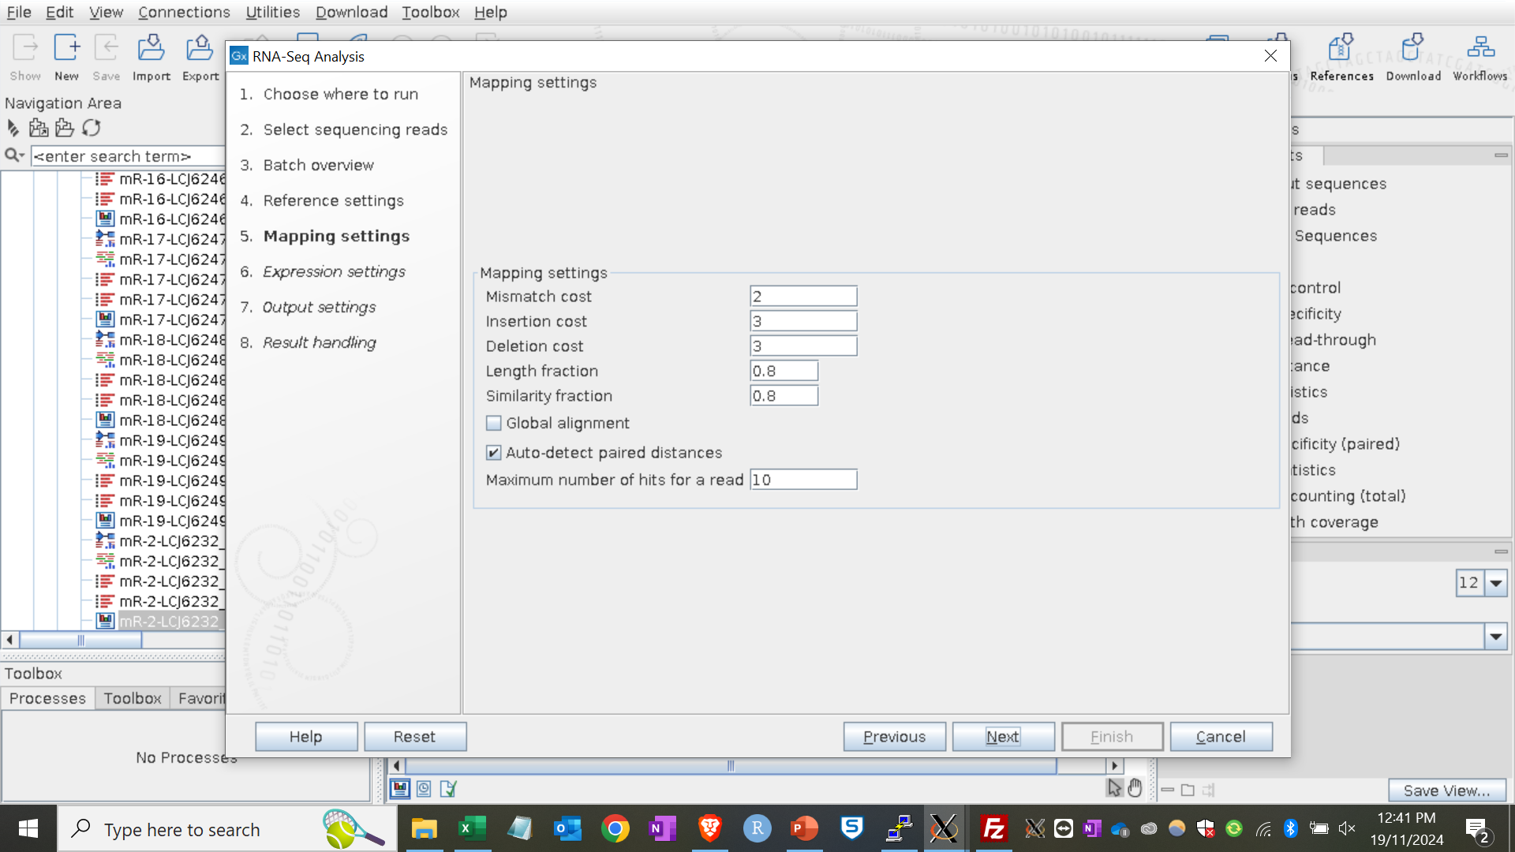
Mapping settings

Slide 33
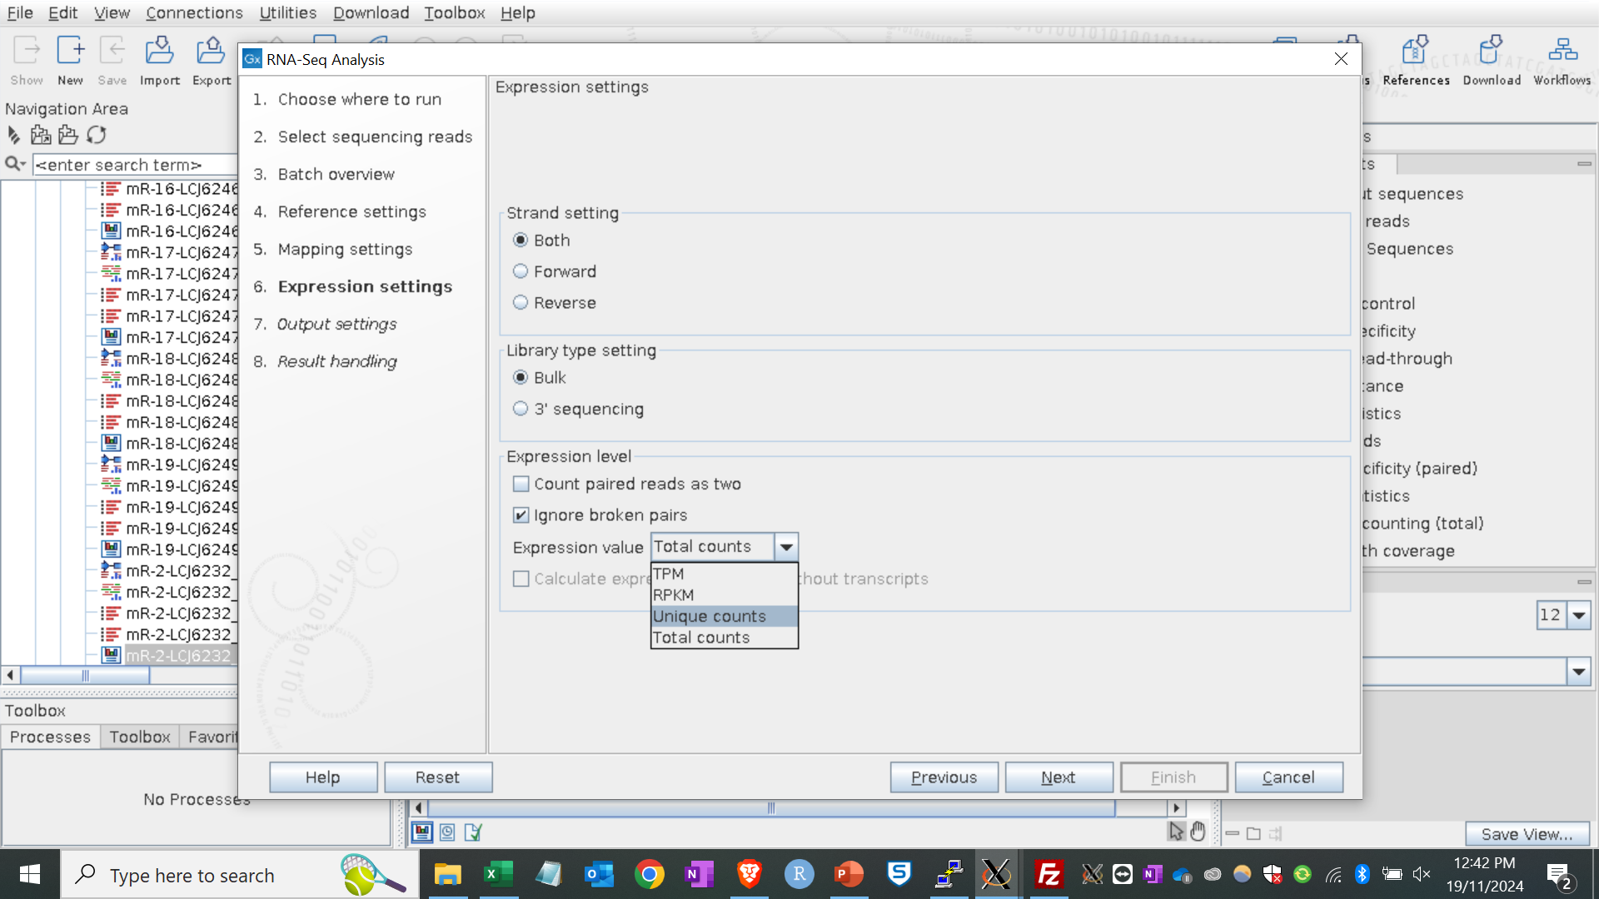
Expression settings

Slide 34
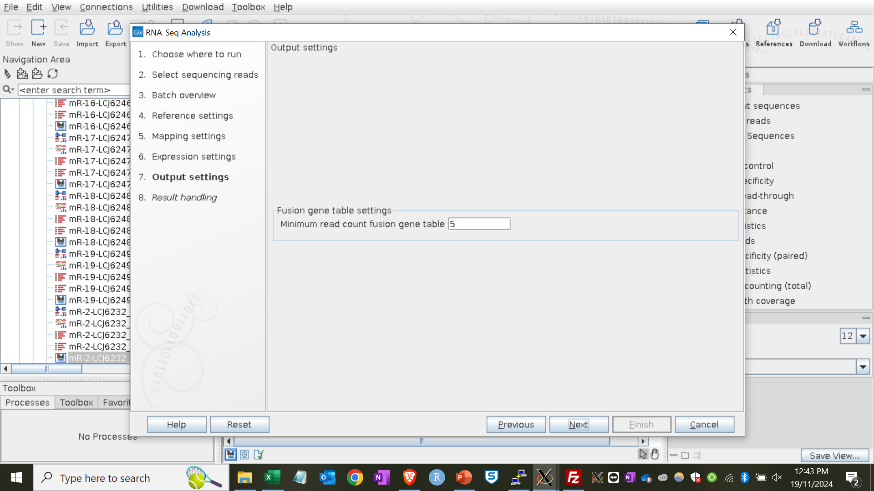
Output table

Slide 35
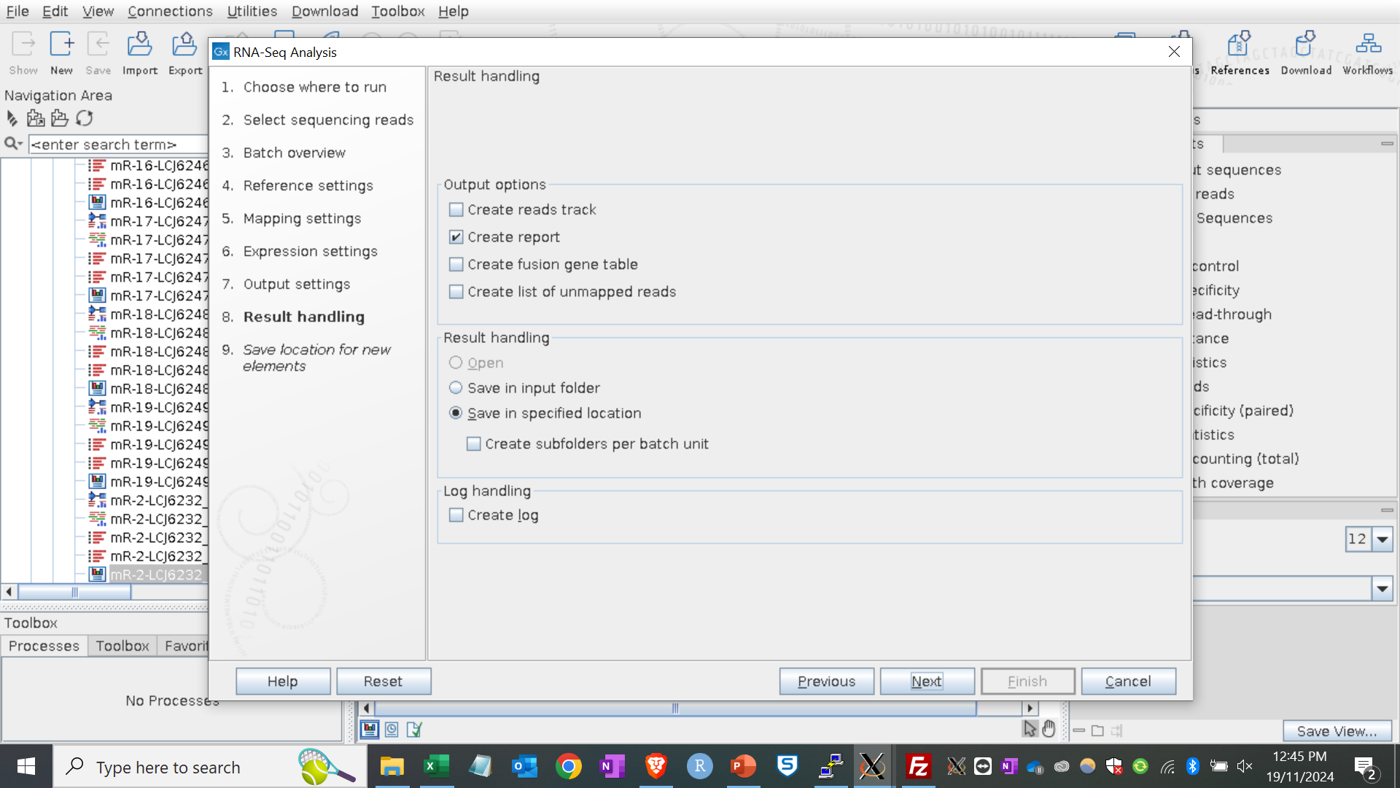
Further output settings

Slide 36
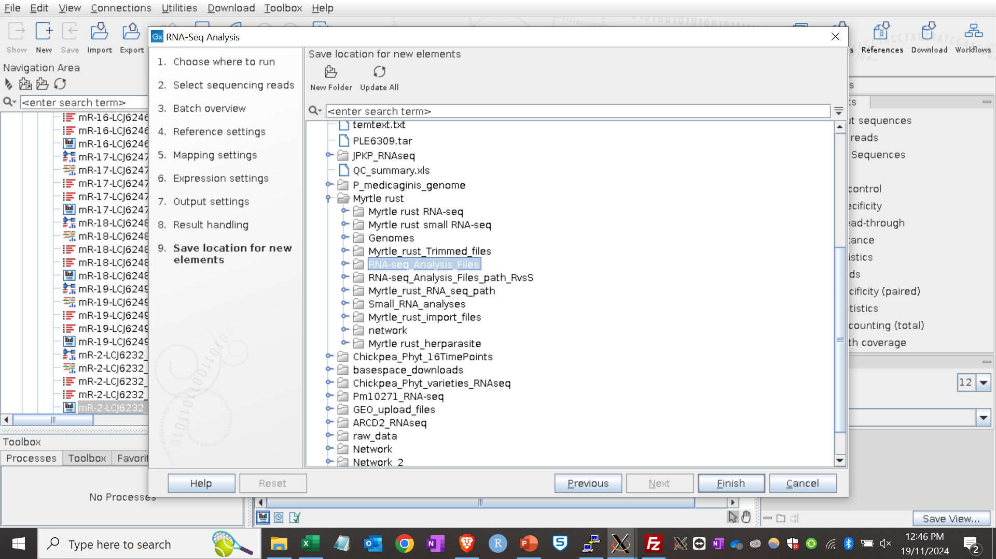
Save results to specified location

Slide 37
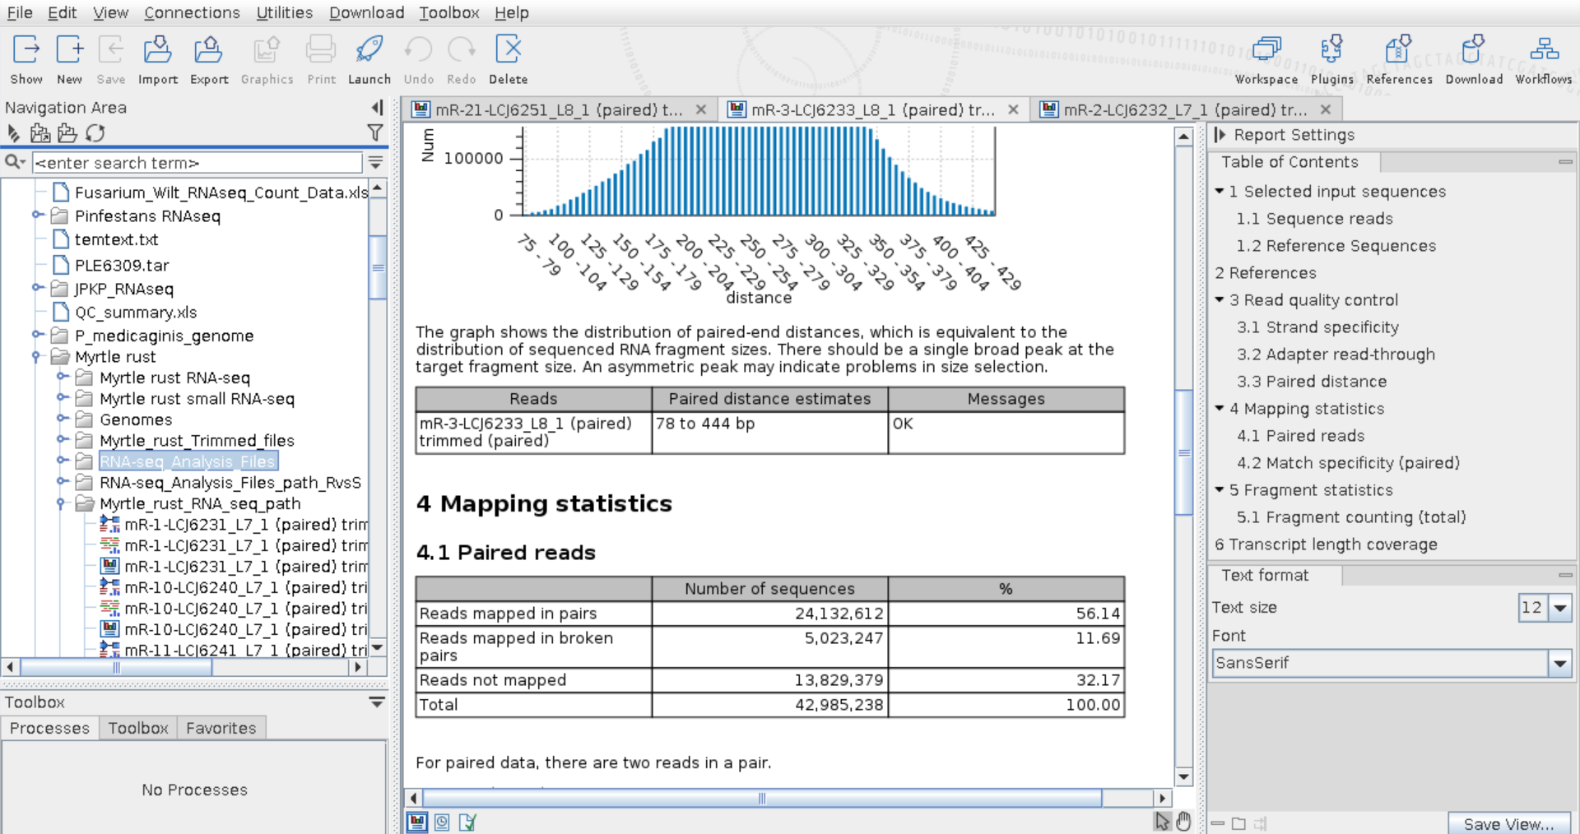
Mapping statistics
Table: mapping statistics of RNA-sequencing samples
Sample name | Treatment | Host/Disease Rating | Number of reads | Reads mapped in pairs | Reads mapped in broken pairs | Reads not mapped
MR1 | Control | Susceptible | 53,356,184 | 29,924,014 (56.08%) | 6,241,457 (11.70%) | 17,190,713 (32.22%)
MR2 | Control | Susceptible | 53,151,728 | 30,006,238 (56.45%) | 6,031,783(11.35%) | 17,113,70, (32.20%)
MR3 | Control | Susceptible | 42,985,238 | 24,132,612 (56.14%) | 5,023,247 (11.69%) | 13,829,379 (32.17%)
MR13 | Control | Resistant | 40,255,044 | 22,847,160 (56.76%) | 6,015,159 (14.94%) | 11,392,725 (28.30%)
MR14 | Control | Resistant | 41,395,906 | 24,773,978 (59.85%) | 4,396,898 (10.62%) | 12,225,030 (29.53%)
MR15 | Control | Resistant | 47,634,484 | 27,711,372 (58.18%) | 5,418,236 (11.37% | 14,504,876 (30.45%)
 |  |  | Total: 278,778,584

Slide 38
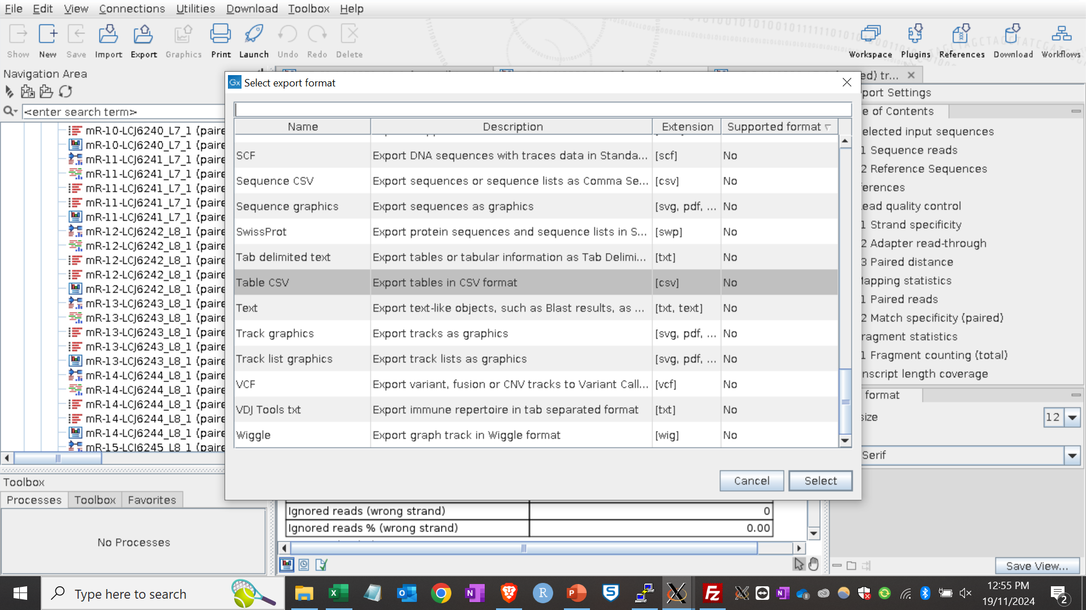
Export count files

Slide 39
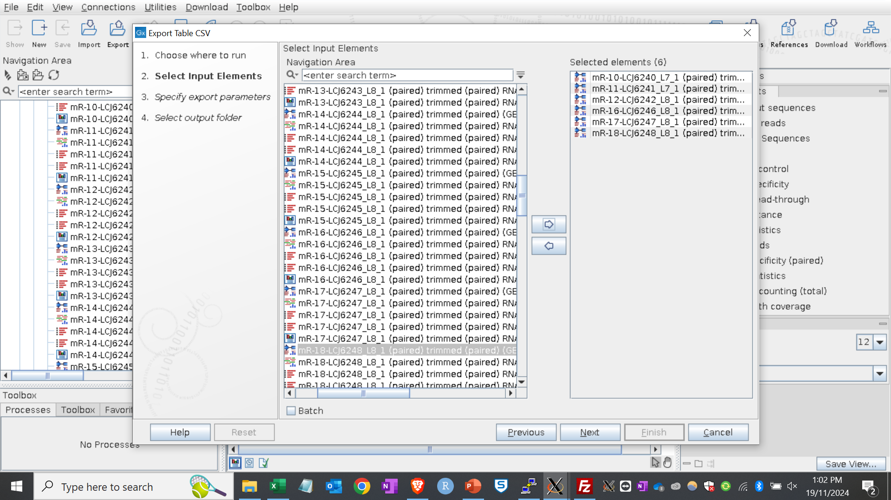
Select files to export

Slide 40
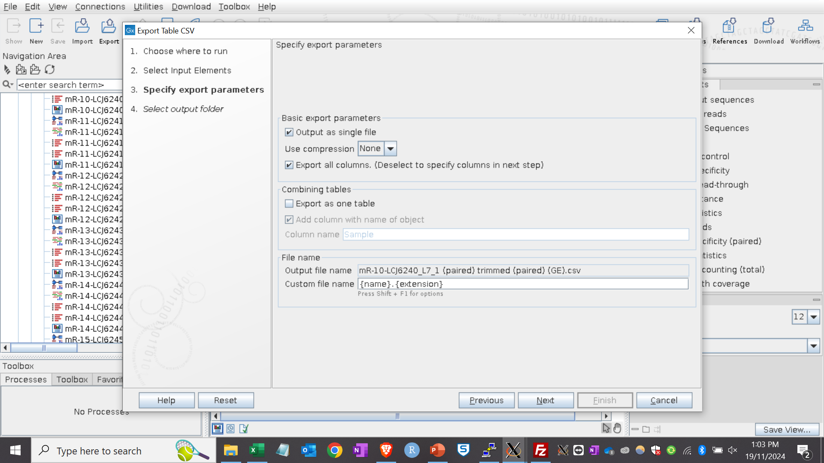
Export parameters

Slide 41
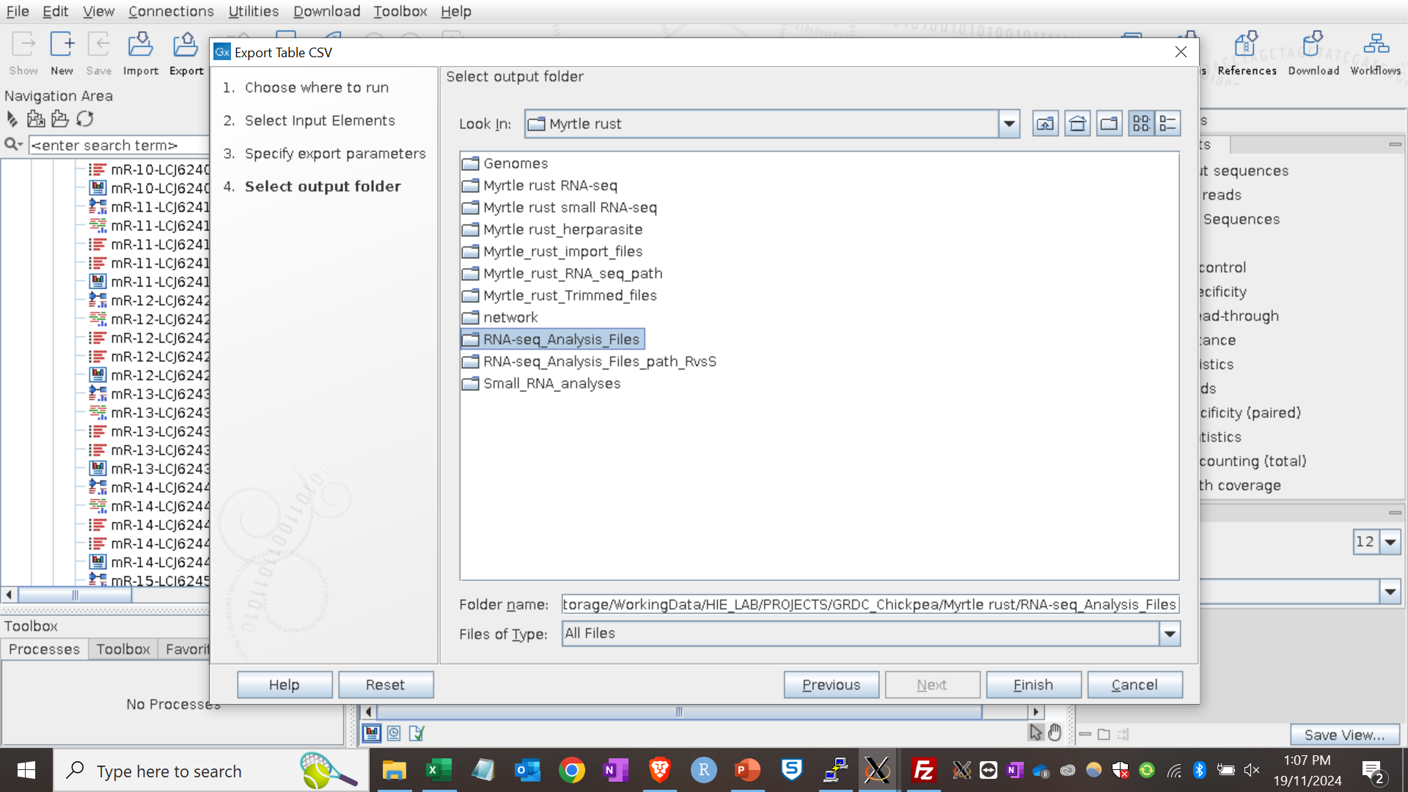
Save in specified location

Slide 42
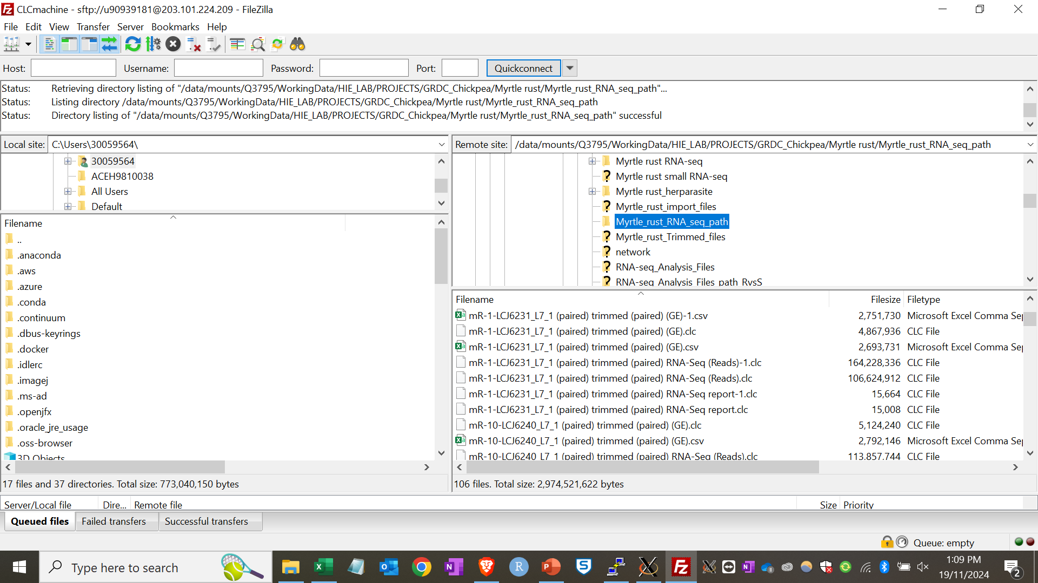
Obtain files from FileZilla

Slide 43
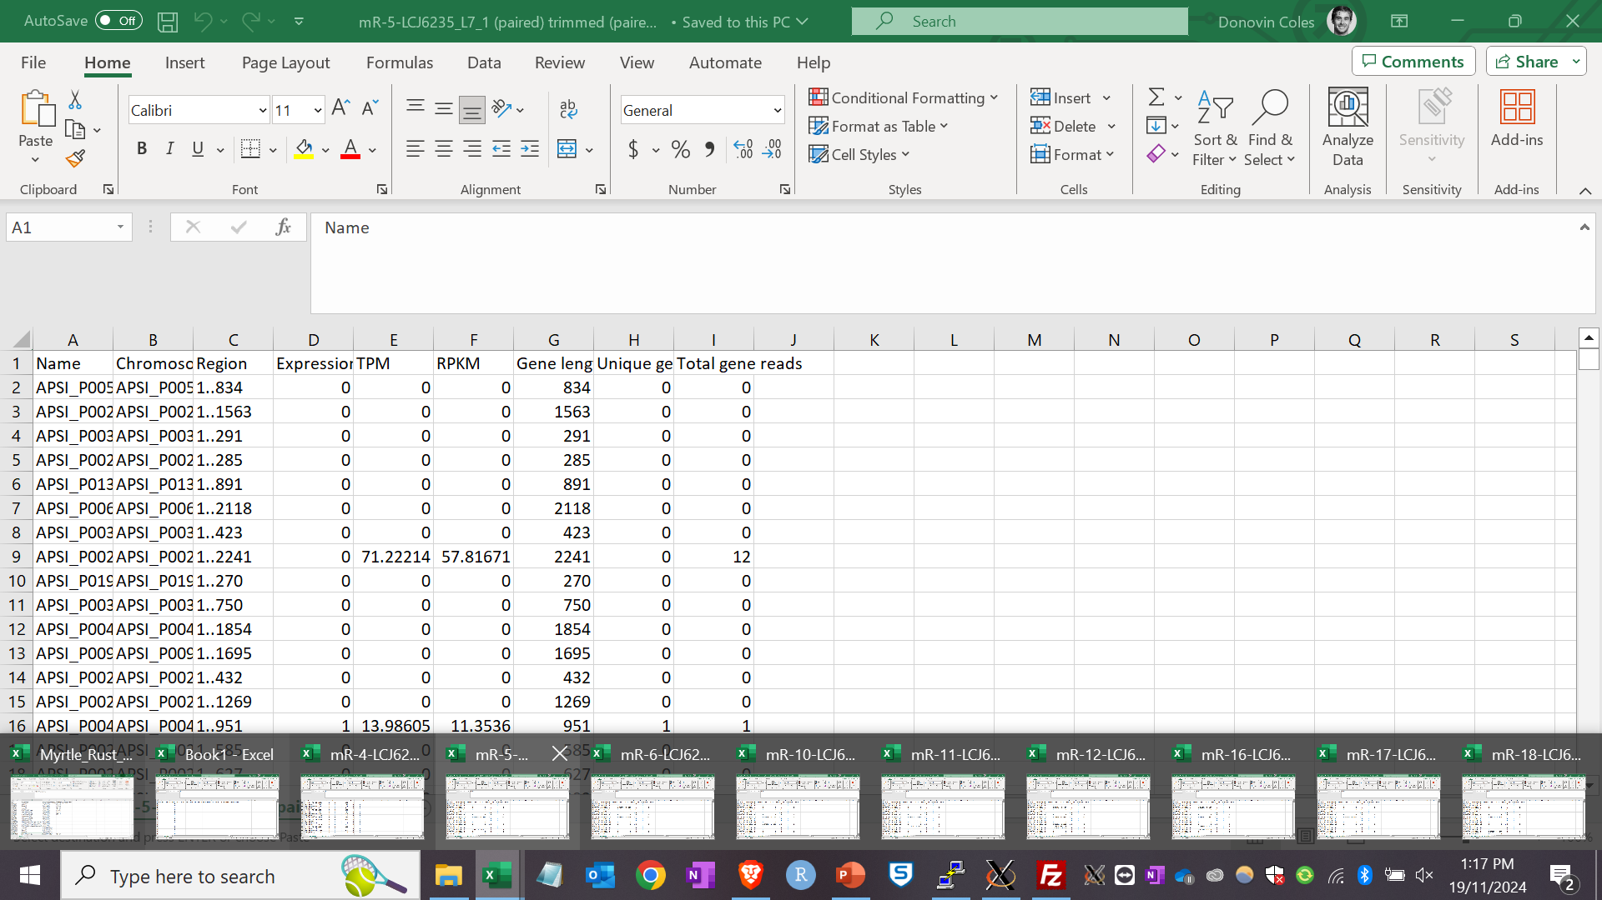
3. Differential expression analysis

Slide 44
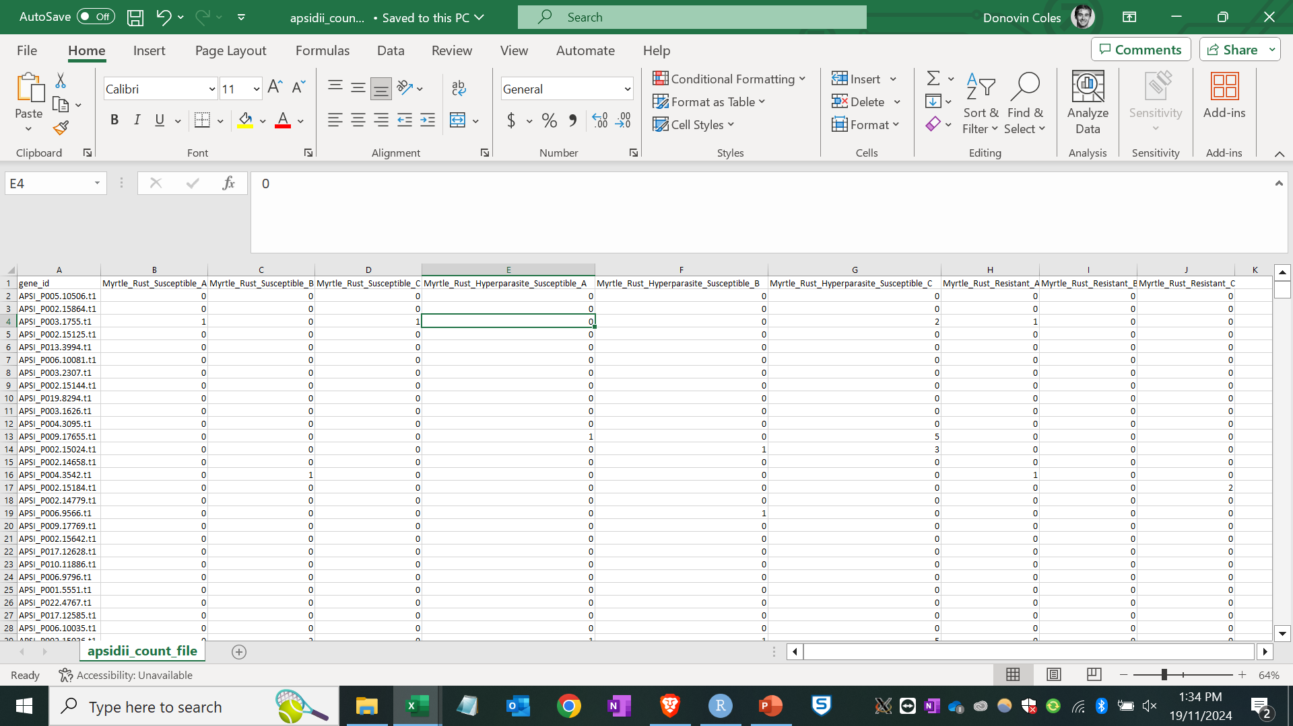
File layout for differential expression

Slide 45


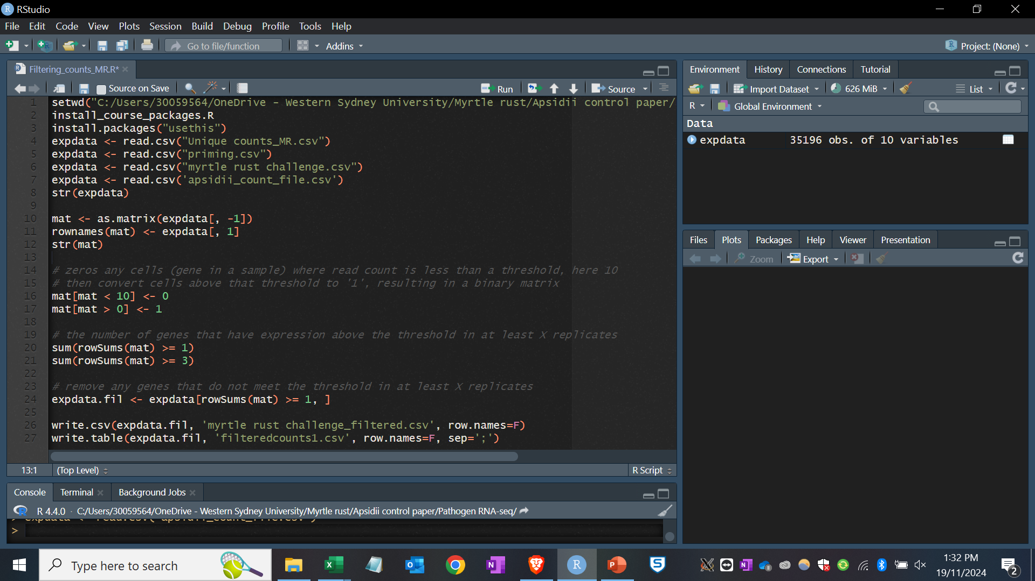
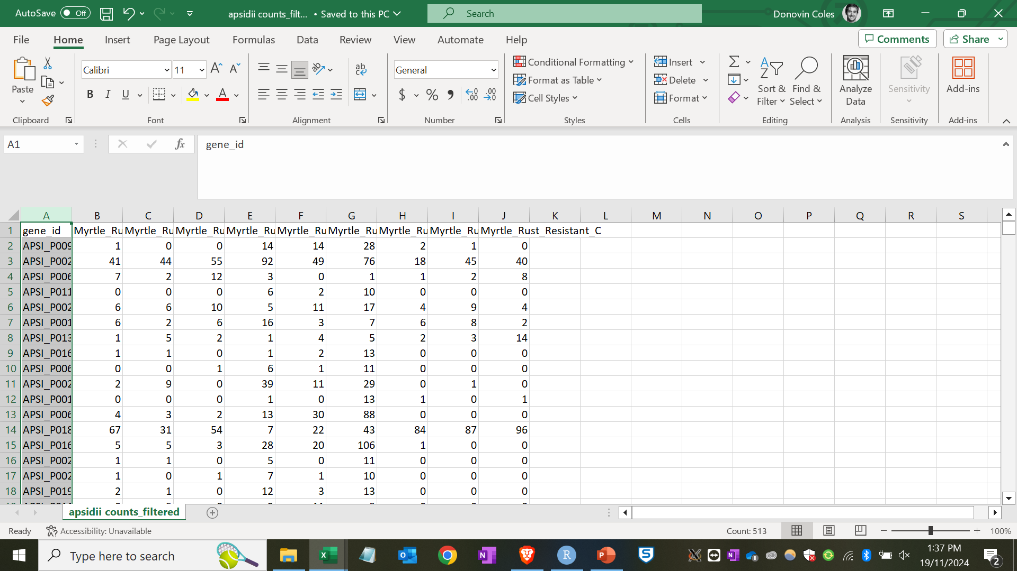
Filtering counts

Slide 46
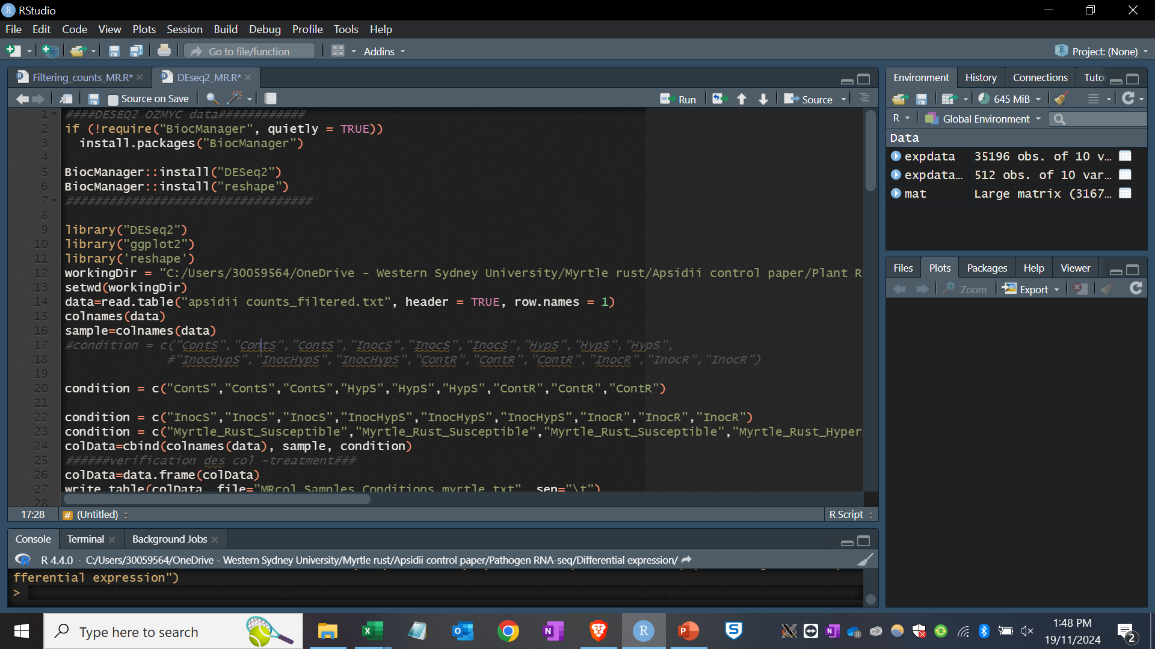
Performing differential expression

Slide 47
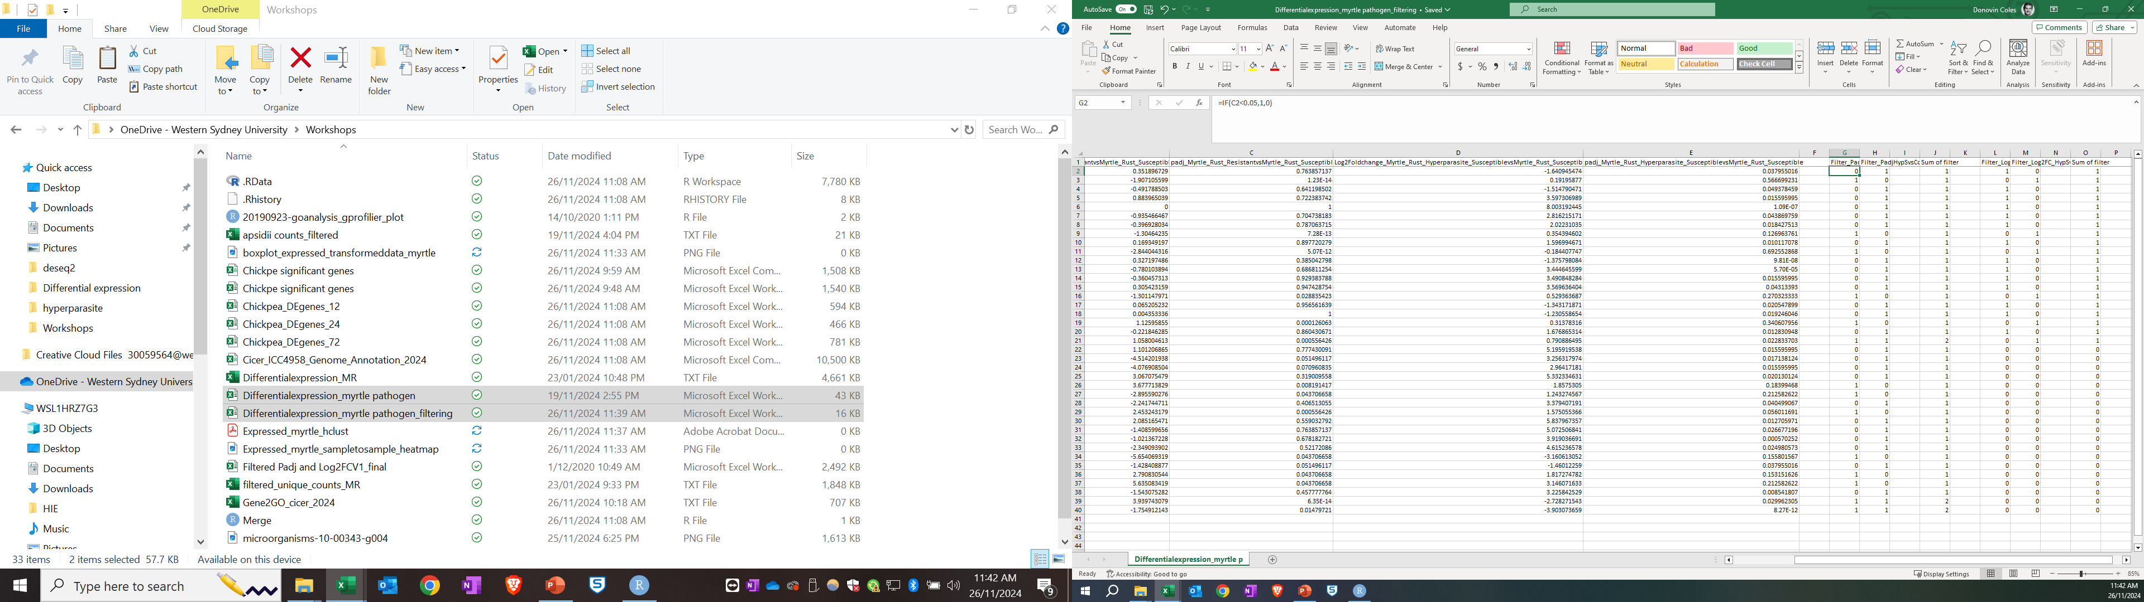
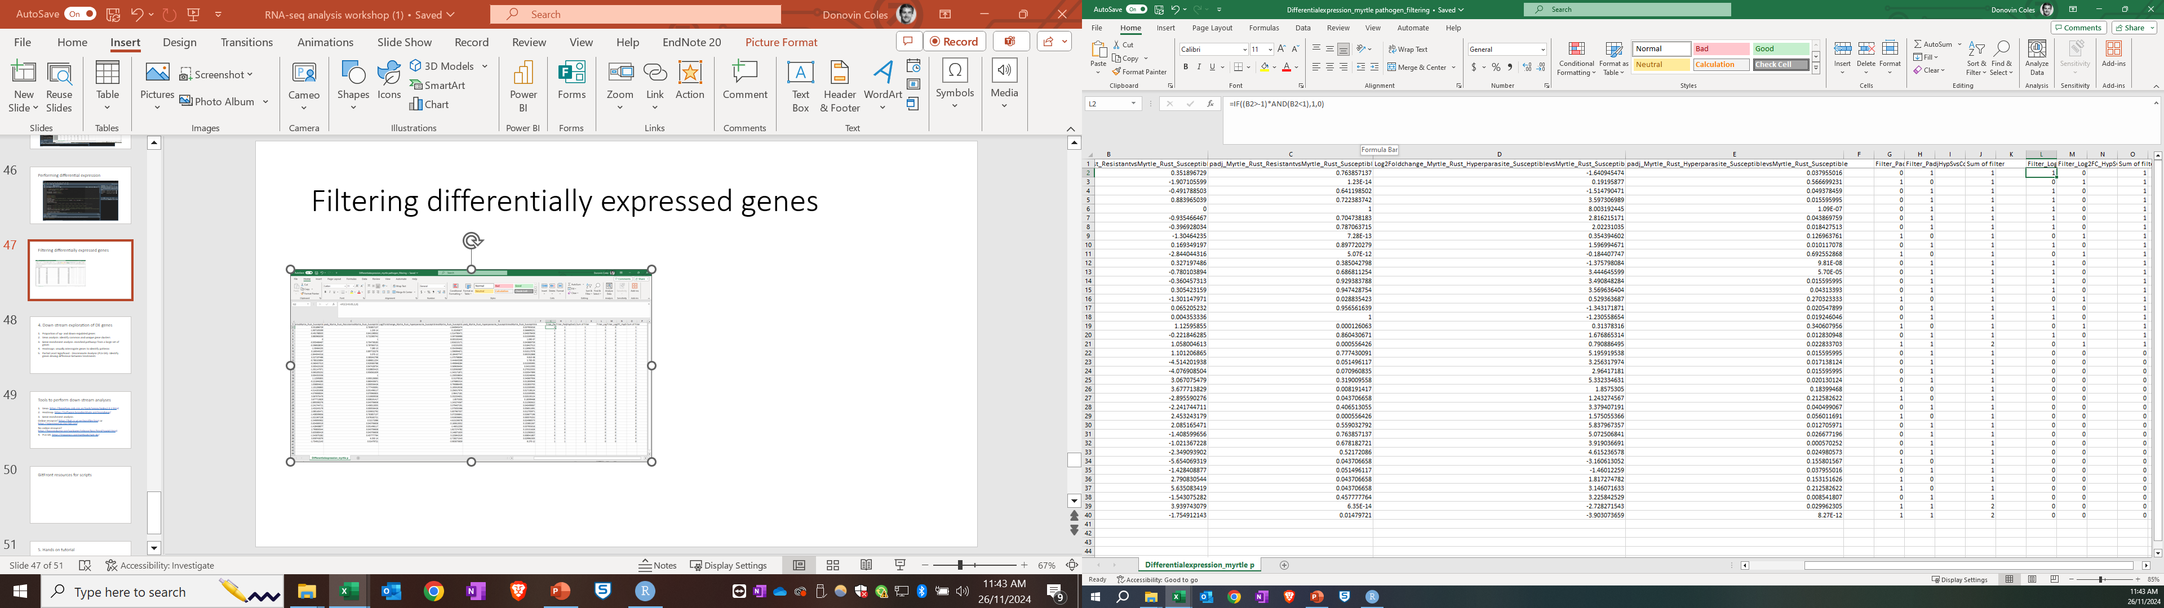
Filtering differentially expressed genes

Slide 48
4. Down-stream exploration of DE genes
Proportion of up- and down-regulated genes
Venn analysis: identify common and unique gene clusters
Gene enrichment analysis: enriched pathways from a large set of genes
Heatmaps: visually interrogate genes to identify patterns
Partial Least Significant - Discriminate Analysis (PLS-DA): Identify genes driving difference between treatments

Slide 49
Tools to perform down-stream analyses
Venn: https://bioinfogp.cnb.csic.es/tools/venny/index2.0.2.html
Heatmap: https://software.broadinstitute.org/morpheus/
Gene enrichment analysis:
Online resource? https://biit.cs.ut.ee/gprofiler/gost or https://plantregmap.gao-lab.org/
No online resource? https://bioconductor.org/packages/release/bioc/html/topGO.html
PLS-DA: https://mixomics.org/methods/spls-da/

Slide 50
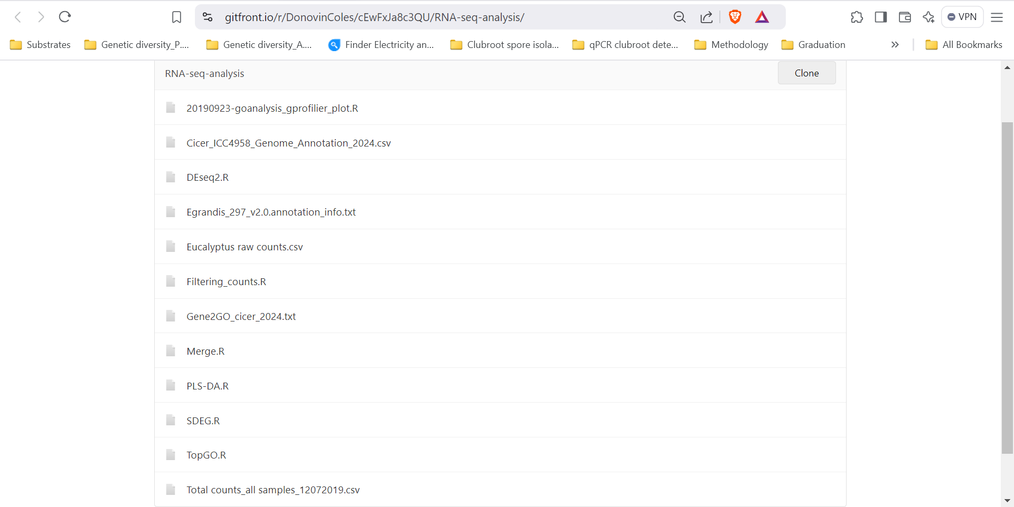
GitFront resources for scripts

Slide 51
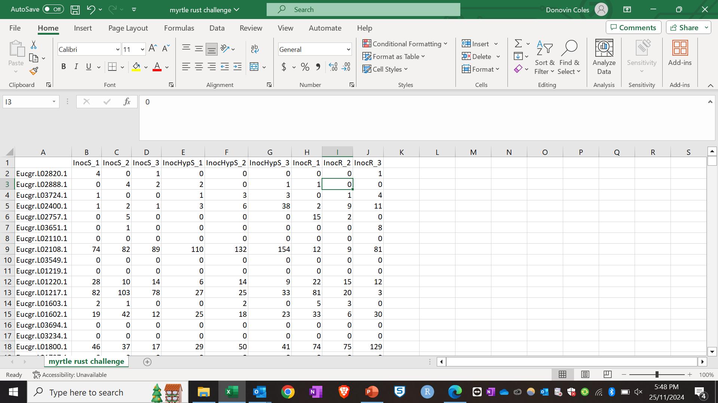
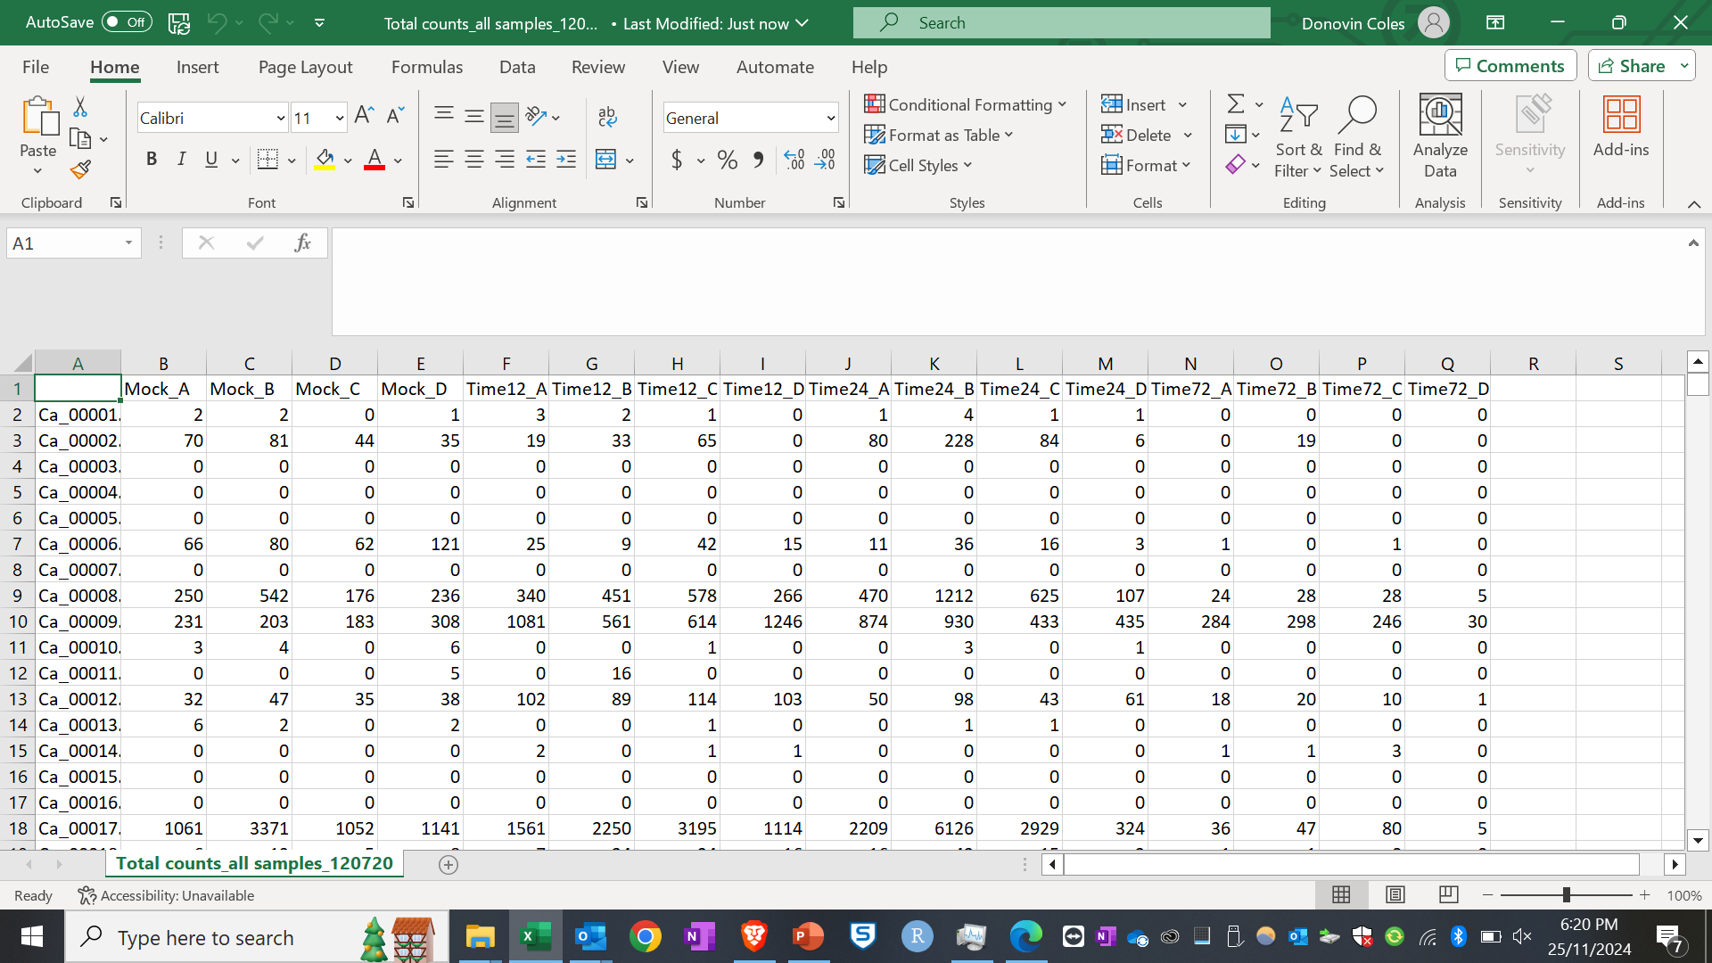
5. Hands on tutorial
Filter a gene count file and identify significantly differentially expressed genes (Files: Eucalyptus raw counts.csv or Total counts_all samples_12072019.csv)
Perform down-stream analyses (whatever your heart desires)

